Slide 1
Software Quality Assurance and Testing Technology
1st Semester, Fall 2022
Xiaoping CHE (xpche@bjtu.edu.cn)
Associate Professor
School of Software Engineering
Beijing Jiaotong University

Slide 2
Rules
Project 20%
Assignments 40%
Final Exam 40%

Slide 3
How
16 Weeks Plan
Week 1: The basic concepts and theories of testing
Week 2-3: Principles of Testing
Week 4-5: White Box Testing
Week 6-7: Test Cases & Black Box Testing
Week 8: Usability Testing
Week 9: Mutation Testing & Finite Automata
Week 10: Mid-term Review and System Testing
Week 11: Empirical Software Testing
Week 12: Interaction System Testing
Week 13-14: ML & AI System Testing
Week 15-16: Conclusion & General Review

Slide 4


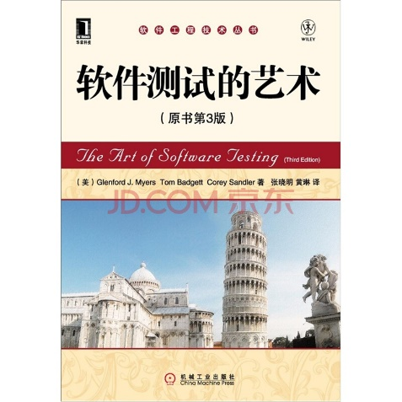


How
References
Ron Patton, Software Testing (2th Edition)
Glenford J. Myers, The Art of Software Testing (3rd Edition)
Gerald M. Weinberg, Perfect Software

Slide 5
Chapter 1 Introduction (Week 1)

Slide 6
16 Weeks Plan
Week 1: The basic concepts and theories of testing
Week 2-3: Principles of Testing
Week 4-5: White Box Testing
Week 6-7: Test Cases & Black Box Testing
Week 8: Usability Testing
Week 9: Mutation Testing & Finite Automata
Week 10: Mid-term Review and System Testing
Week 11: Empirical Software Testing
Week 12: Interaction System Testing
Week 13-14: ML & AI System Testing
Week 15-16: Conclusion & General Review

Slide 7
What is Testing
Software testing is a process, or a series of processes, designed to make sure computer code does what it was designed to do and, conversely, that it does not do anything unintended.
System
Input
Output

Slide 8
Test Cycle
Test
cases
Execution of cases
Additional tests
Results
Suspected causes
Regression tests
Evaluation
Corrections
Identified causes
Debugging

Slide 9
What is Testing
Level of detail
system
integration
module
unit
security
Accessibility
robustness
white box
black box
performance
usability
reliability
functional behaviour
Characteristics

Slide 10
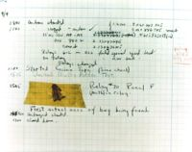
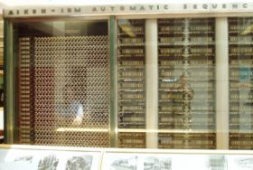
Introduction
What is a computer bug?
In 1947 Harvard University was operating a room-sized computer called the Mark II.
A moth flew into the computer and was zapped by the high voltage when it landed on a relay.
Hence, the first computer bug!

Slide 11
Introduction
Bugs a.k.a. …
Defect
Fault
Problem
Error
Incident
Anomaly
Variance
Failure
Inconsistency
Product Anomaly
Product Incidence
Feature

Slide 12
Introduction
Fault, Error & Failure
Software Fault : A static defect in the software (i.e., defect)
Software Error : An incorrect internal state that is the manifestation of some fault
Software Failure : External, incorrect behavior with respect to the requirements or other description of the expected behavior

Slide 13
Introduction
Software Fault : A static defect in the software (i.e., defect, bug)
public static void CSta (int [ ] numbers)
{
int length = numbers.length;
double mean, sum;
sum = 0.0;
for (int i = 1; i < length; i++)//i=0
{
sum += numbers [ i ];
}
mean = sum / (double) length;
System.out.println ("mean: " + mean);
}
Fault

Slide 14
Introduction
Software Error : An incorrect internal state that is the manifestation of some fault
public static void CSta (int [ ] numbers)
{
int length = numbers.length;
double mean, sum;
sum = 0.0;
for (int i = 1; i < length; i++)//i=0
{
sum += numbers [ i ];
}
mean = sum / (double) length;
System.out.println ("mean: " + mean);
}
Test Input: [3,4,5]
Error
sum=3+4+5
sum=4+5

Slide 15
Introduction
Software Failure : External, incorrect behavior with respect to the requirements or other description of the expected behavior
public static void CSta (int [ ] numbers)
{
int length = numbers.length;
double mean, sum;
sum = 0.0;
for (int i = 1; i < length; i++)//i=0
{
sum += numbers [ i ];
}
mean = sum / (double) length;
System.out.println ("mean: " + mean);
}
Test Input: [3,4,5]
sum=3+4+5
sum=4+5
failure
mean=4
mean=3

Slide 16
Introduction
PIE Model
Execution/Reachability : The location or locations in the program that contain the fault must be reached
Infection : The state of the program must be incorrect
Propagation : The infected state must propagate to cause some output of the program to be incorrect

Slide 17
Introduction
A test executing the fault may not produce an error!
public static void CSta (int [ ] numbers)
{
int length = numbers.length;
double mean, sum;
sum = 0.0;
for (int i = 1; i < length; i++)//i=0
{
sum += numbers [ i ];
}
mean = sum / (double) length;
System.out.println ("mean: " + mean);
}
Test Input: [0,4,5]
sum=0+4+5
sum=4+5
Not an error for “sum”
mean=3
mean=3

Slide 18
Introduction
An error may not be propagated to the output!
public static void CSta (int [ ] numbers)
{
int length = numbers.length-1;
double mean, sum;
sum = 0.0;
for (int i = 0; i < length; i++)
{
sum += numbers [ i ];
}
mean = sum / (double) length;
System.out.println ("mean: " + mean);
}
Test Input: [3,5,4]
Error
sum=3+5+4
sum=3+5
mean=12/3=4
mean=8/2=4
No Failure
18

Slide 19
Introduction
Defective Software
We develop programs that contain defects
How many? What kind?
Hard to predict the future, however…it is highly likely, that the software we (including you!) will develop in the future will not be significantly better. ☹

Slide 20
Introduction
Sources of Problems
Requirements Definition: Erroneous, incomplete, inconsistent requirements.
Design: Fundamental design flaws in the software.
Implementation: Mistakes in chip fabrication, wiring, programming faults, malicious code.
Support Systems: Poor programming languages, faulty compilers and debuggers, misleading development tools.

Slide 21
Introduction
Sources of Problems (Cont’d)
Inadequate Testing of Software: Incomplete testing, poor verification, mistakes in debugging.
Evolution: Sloppy redevelopment or maintenance, introduction of new flaws in attempts to fix old flaws, incremental escalation to inordinate complexity.

Slide 22
Introduction
Adverse Effects of Faulty Software
Communications: Loss or corruption of communication media, non delivery of data.
Space Applications: Lost lives, launch delays.
Defense and Warfare: Misidentification of friend or foe.

Slide 23
Introduction
Adverse Effects of Faulty Software (Cont’d)
Transportation: Deaths, delays, sudden acceleration, inability to brake.
Safety-critical Applications: Death, injuries.
Electric Power: Death, injuries, power outages, long-term health hazards (radiation).

Slide 24
Introduction
Adverse Effects of Faulty Software (Cont’d)
Money Management: Fraud, violation of privacy, shutdown of stock exchanges and banks, negative interest rates.
Control of Elections: Wrong results (intentional or non-intentional).
Control of Jails: Technology-aided escape attempts and successes, accidental release of inmates, failures in software controlled locks.
Law Enforcement: False arrests and imprisonments.

Slide 25
Introduction
System Functional requirements
Other software requirements
Customer requirements Specification
Unit Test
Design Specification
User Environment
Unit Test
Components
Integration Test
Function Test
System Test
Acceptance Test
Installation Test
Integrated modules
Functioning system
Verified, validated software
Accepted test
System in use
Unit Test

Slide 26
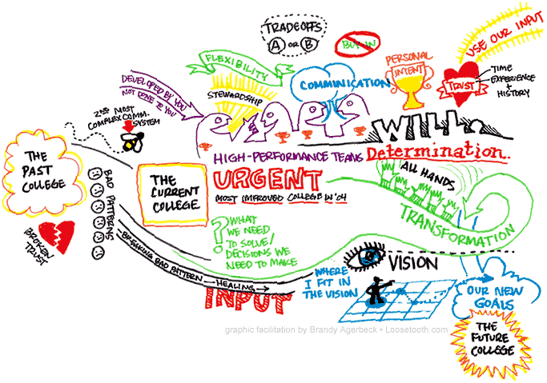
Introduction
Specification “if you can’t say it, you can’t do it”
not written.
not thorough enough.
constantly changing.
not communicated to the entire team in a timely manner.

Slide 27
Introduction
Specification “if you can’t say it, you can’t do it”
You have to know what your product is before you can say if it has a bug.
A specification defines the product being created and includes:
Functional requirements that describes the features the product will support. E.g., on a word processor
Save, print, check spelling, change font, …
Non-functional requirements are constraints on the product. E.g,
Security, reliability, user friendliness, platform, …

Slide 28
Introduction
A software bug occurs when at least one of these rules is true
The software does not do something that the specification says it should do.
The software does something that the specification says it should not do.
The software does something that the specification does not mention.
The software does not do something that the product specification does not mention but should.
The software is difficult to understand, hard to use, slow …

Slide 29
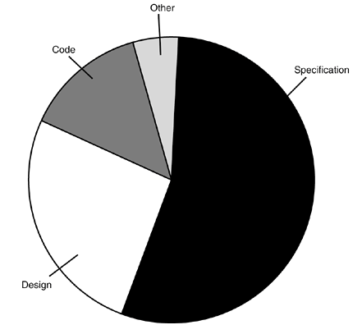
Introduction
Most bugs are not because of mistakes in the code …
Specification (~= 55%)
Design (~= 25%)
Code (~= 15%)
Other (~= 5%)

Slide 30
Introduction
Relative cost of bugs “bugs found later cost more to fix”
Cost to fix a bug increases exponentially (10^{x})
i.e., it increases tenfold as time increases
E.g., a bug found during specification costs $1 to fix.
… if found in design cost is $10
… if found in code cost is $100
… if found in released software cost is $1000

Slide 31
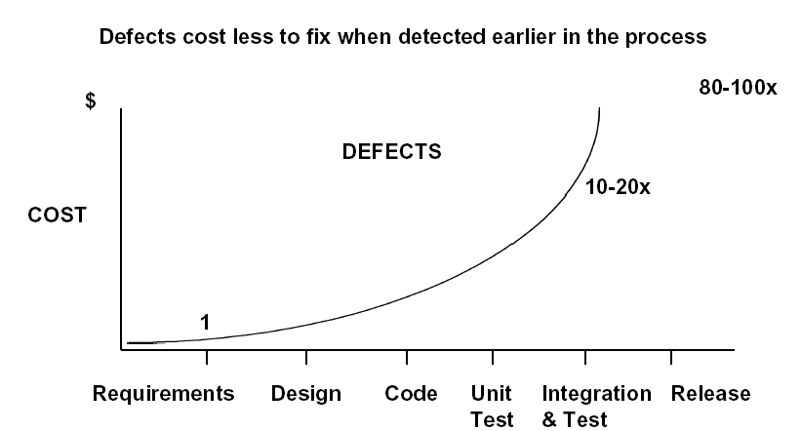
Introduction

Slide 32
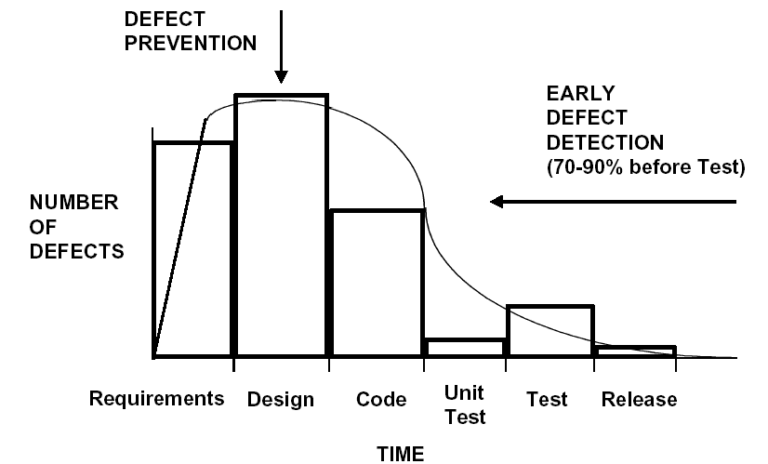
Introduction

Slide 33
The Cost of bugs
Introduction

Slide 34
Introduction
Bug Free Software
Software is in the news for the wrong reason
Security breach, Mars Lander lost, hackers getting credit card information, etc.
Why can’t software engineers develop software that just works?
As software gets more features and supports more platforms it becomes increasingly difficult to make it create bug-free.

Slide 35
Introduction
Discussion …
Do you think bug free software is unattainable?
Are their technical barriers that make this impossible?
Is it just a question of time before we can do this?
Are we missing technology or processes?

Slide 36
Introduction
Goal of a software tester
… to find bugs
… as early in the software development processes as possible
… and make sure they get fixed.
Advice: Be careful not to get caught in the dangerous spiral of unattainable perfection.

Slide 37
DEBUGGING vs. TESTING
TESTER DEBUGGER
Developer Developer
Test team Analyst
QA team
End user
THERE IS A FUNDAMENTAL CONFLICT BETWEEN THESE ROLES

Slide 38
TESTING
The operation of a system or application under controlled conditions and the evaluation of results with the intent of finding errors.
Should include normal and abnormal conditions
Testing intentionally attempts to make things go wrong to determine:
if things happen when they shouldn’t
if things don’t happen when they should
Oriented towards “detection”

Slide 39
DEBUGGING
DEBUGGING starts with an identified error and is the process of locating what is causing the bug and correcting the flaw.
It is NOT the process of showing that a bug exists.
Oriented towards “correction”.

Slide 40
Introduction
What to look for when interviewing someone for the position of software tester
Are they explorers?
Are they troubleshooters?
Are they relentless?
Are they creative?
Are they perfectionists (within reason)?
Do they exercise good judgment?
Are they tactful and diplomatic?
Are they persuasive?

Slide 41
Introduction
You now know …
… what is a bug
… the relationship between specification and bugs
… the cost of a bug relative to when it is found
… the unattainable goal of perfect software
… the goal of the software tester
… valuable attributes of a software tester

Slide 42
Chapter 2 Principle of Testing (Week 2-3)

Slide 43
16 Weeks Plan
Week 1: The basic concepts and theories of testing
Week 2-3: Principles of Testing
Week 4-5: White Box Testing
Week 6-7: Test Cases & Black Box Testing
Week 8: Usability Testing
Week 9: Mutation Testing & Finite Automata
Week 10: Mid-term Review and System Testing
Week 11: Empirical Software Testing
Week 12: Interaction System Testing
Week 13-14: ML & AI System Testing
Week 15-16: Conclusion & General Review

Slide 44

Principle of Testing
Software is …
Requirements specification documents
Design documents
Source code
Test suites and test plans
Interfaces to hardware and software operating environment
Internal and external documentation
Executable programs and their persistent data

Slide 45
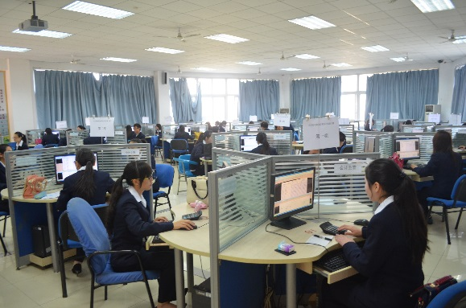
Principle of Testing
Software effort
Specification
Product reviews
Design
Scheduling
Feedback
Competitive information
acquisition
Test planning
Customer surveying
Usability data gathering
Look and feel specification
Software architecture
Programming
…

Slide 46
Product Components
Customer Requirements (Surveys, competitive info, Feedback)
MRD (Task/Feature description, Usability Data)
Specifications
Schedule
Design Docs (Architecture, Feature implementation, Interface agreement)
Test Documents (Plans, test cases, QA Milestone reports)
Online help
Release Notes / Read Me
Release packages

Slide 47
Principle of Testing
Customer requirements
The software development team must determine what the customer wants.
How can you do this?
Guess?
Collect detailed information from surveys?
Get feedback from a previous version of the software?
Read reviews in magazines?
Get information about the competition?
Other ways?
The collected data is used to guide the specification effort.

Slide 48
Writing MRD AND SPEC
Principle of Testing
a project management issue - but a difficult one
For our purposes, verifiability is critical:
(bad) The system should be easy to use and user errors should be minimal.
(better) Experienced controllers should be able to use all the system functions after a total of two-hours of training.
After training, the average number of errors made by the experienced controllers will not exceed two per day.
But there are still problems. What are they?

Slide 49
Principle of Testing
Specification “If you don't know where you're going any road will take you there”
The specification takes the data from the customer requirements and other sources and defines:
The features of the software (functional requirements).
The constraints on these features (non-functional requirements).
Specifications can be:
formal (e.g., aerospace industry), rigid
informal (e.g., a .com start up), on a cocktail napkin or a whiteboard.

Slide 50
SOME WAYS TO QUANTIFY
Principle of Testing
Speed:
Processed transactions/second; user-response time; screen refresh time.
Size:
Number of bytes; number of records; number of transactions.
Ease of use:
Training time; number of help frames; define classes of users objectively

Slide 51
Principle of Testing
SOME WAYS TO QUANTIFY
Reliability:
Mean time to failure; probability of unavailability; rate of failure occurrence; availability.
Robustness:
Time to restart after failure; percentage of events causing failure; probability of data corruption on failure.
Portability:
Percentage of target-dependent statements; number of target systems.

Slide 52
Principle of Testing
Schedules
The goals of scheduling are to know:
What work needs to be completed?
How much work is left to do?
When will the work be finished?
Who will finish each task?
Other measurable queries.
A Gantt chart is a popular type of bar chart that illustrates a project schedule.

Slide 53
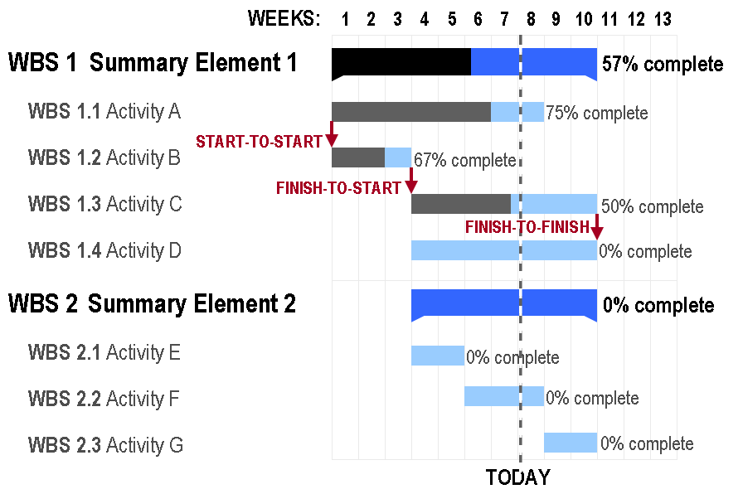
Principle of Testing
Gantt Chart

Slide 54
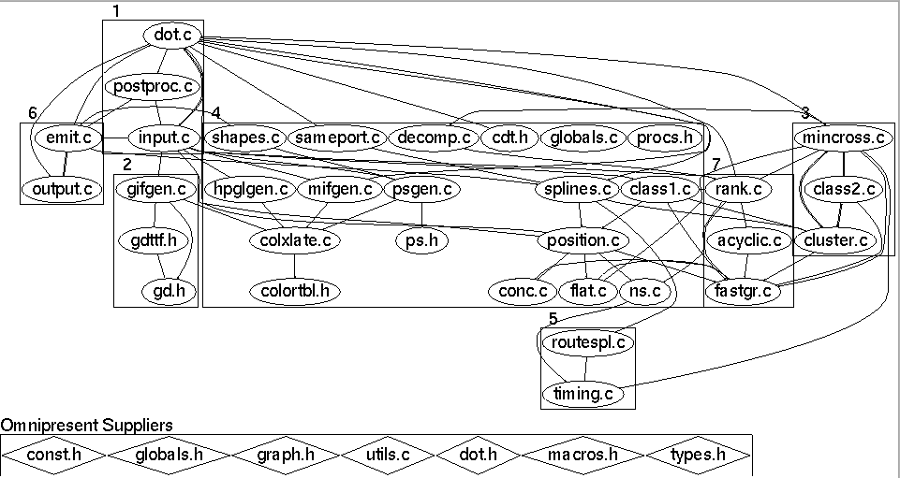
Principle of Testing
Design
Before coding begins on non-trivial software projects, a set of design documents are created to serve as blueprints.
Software Architecture
Data flow diagram
State transition diagram
Flowchart
Commented code

Slide 55
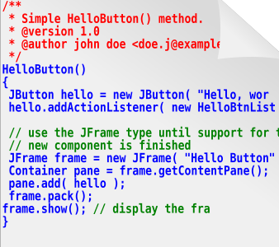
Principle of Testing
Source code … of course
The ultimate specification of the software!
‘Code is king’ philosophy is still prevalent.
Many programming languages and tools to choose from.

Slide 56
Principle of Testing
Test documents
Test plan
Quality objectives, resource needs, schedules, assignments, methods, etc.
Test cases
Inputs and expected outputs.
Bug reports
E.g., the Bugzilla web-based bug tracker.
Test tools and automation
Metrics, statistics, and summaries
Number of unresolved bugs, mean time to repair a bug, etc.

Slide 57
Principle of Testing
Software Project Staff
Project managers
Write product specification, manage the schedule, critical decision tradeoffs
Software architects, system engineers
Design the software, work closely with programmers
Programmers, developers, coders
Write code, fix bugs
Testers, quality assurance staff
Find bugs, document bugs, track progress of open bugs
Technical writers
Write manuals, on line documentation
Configuration managers, builders
Packaging and code, documents, and specifications

Slide 58
SD Team
图DEV-oriented model
DEV manager
Tester
Programmer
DOC
Management
PM
PM
Test Lead
DEV lead
DOC
Test Manager
DEV Manager
图PM-Oriented model
Tri-Model

Slide 59
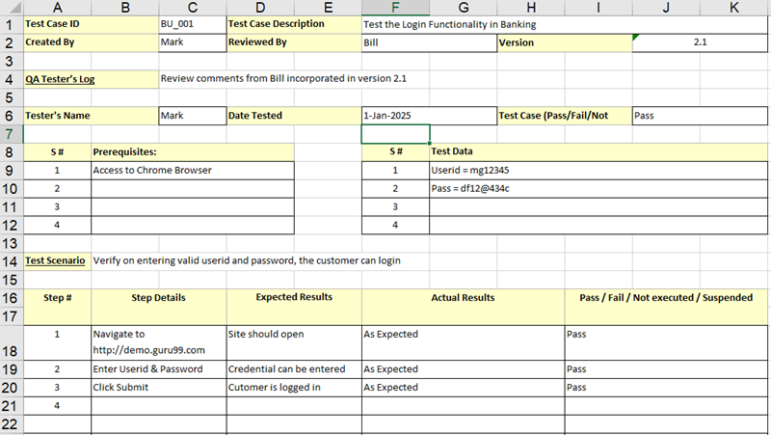
Example (Test case)

Slide 60
THE SOFTWARE LIFE CYCLE
Begins when an application is first conceived.
Ends when it is no longer in use.
Includes:
Initial conception
Requirements/ specification analysis
Functional design
Internal design
Documentation planning
Test planning
Coding
Documenting
Integration
Testing
Maintenance
Updates
Retesting
Phase-out
Many different models are possible for sequencing
these activities!

Slide 61
Activities in SDLC
Project Planning
Analysis
Design
Implement
Test
Roll-out
Initiate project & Organize
UI Design
User Req’ts
Req’ts Analysis
Project Definition & Planning
Technical Design
Detailed Design
Perform Integration Test
Perform System Test
Coding
Convert Site
Quality Requirements
Management Review & Approval
Quality Verification
Test Planning & Preparation
User Procedure & Training
Roll-out Planning & Preparation

Slide 62
Waterfall Model with Prototyping
Requirements Analysis
System Design
Program Design
Coding Unit Test
Integration Testing
Prototyping
System Testing
User/Customer
Acceptance Testing
Operation maintenance

Slide 63
Rapid Application Development (RAD) - V Model
Operation maintenance
Validate requirements
Requirements Analysis
Acceptance Testing
System Design
System Testing
Verify design
Program Design
Unit Test Integration Testing
Design/Analysis
Verify/testing
Coding

Slide 64
VERIFICATION
The process of evaluating a system or component during the development process to determine whether it satisfies the specifications.
THE CRITICAL QUESTION IS:
- Did we build what we planned to build?
Typically involves reviews and meetings to evaluate:
documents
plans
code
requirements
specifications

Slide 65
VALIDATION
The process of evaluating a system or component during the development process to determine whether it satisfies the user's requirements
THE CRITICAL QUESTION IS
“Did we build what the user wanted?”

Slide 66
Verification vs. Validation
Verification confirms that the software meets its specification.
- Are we building the product right？
Validation confirms that the software meets the user’s requirements.
- Are we building the right product ?
Never assume the specifications are correct when testing, Both V&V tests must be performed.
Example: The mirror of Hubble Space Telescope was ground incorrectly (because the specs were wrong) and, consequently, it failed to produce clear pictures when originally launched.

Slide 67
Principle of Testing
?
Which one sounds correct …
Testing is the process of demonstrating that errors are not present.
The purpose of testing is to show that a program performs its intended functions correctly.
Testing is the process of executing a program with the intent of finding errors.
Testing is the process of establishing confidence that a program does what it is supposed to do.

Slide 68
Principle of Testing
Software process models are an ideal … not reality
No software development effort follows a process model perfectly. Why?
The specification never corresponds to the customers needs perfectly.
There is never enough time to perform all of the testing.
Nevertheless, an ideal model is helpful to make progress.
Trade offs and concessions are inevitable.

Slide 69
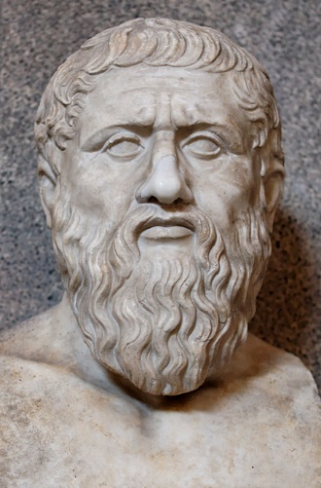
Principle of Testing
Plato had some interesting things to say about the ideal
Physical objects and physical events are shadows of their ideal or perfect forms
They exist only to the extent that they instantiate the perfect versions of themselves.
However, real physical objects are fleeting phenomena, the ideals of which they are mere instances.
Plato believed in perfect justice, perfect chairs, etc.
He would have also believed that the Waterfall model (or some variant of it) was a perfect process model :-)
427 – 347 B.C.

Slide 70
Principle of Testing
Software testing axioms
It is impossible to test a program completely.
Software testing is a risk-based exercise.
Testing cannot show the absence of bugs.
The more bugs you find, the more bugs there are.
Not all bugs found will be fixed.
It is difficult to say when a bug is indeed a bug.
Specifications are never final.
Software testers are not the most popular members of a project.
Software testing is a disciplined and technical profession.

Slide 71
Principle of Testing
Parenthesis: What is an axiom anyway?
An axiom is a sentence or proposition that is not proved or demonstrated and is considered as obvious or as an initial necessary consensus for a theory building or acceptation.
Therefore, it is taken for granted as true, and serves as a starting point for deducing and inferring other (theory dependent) truths.

Slide 72

Principle of Testing
Peano’s axioms for the structure of natural numbers
1 is a natural number.
Every natural number is equal to itself (equality is reflexive).
For all natural numbers a and b, a = b if and only if b = a (equality is symmetric).
For all natural numbers a, b, and c, if a = b and b = c then a = c (equality is transitive).
If a = b and b is a natural number then a is a natural number.
If a is a natural number then successor(a) is a natural number.
If a and b are natural numbers then a = b if and only if successor(a) = successor(b).
If a is a natural number then successor(a) is not equal to 1.
For every set K, if 1 is in K, and successor(x) is in K for every natural number x in K, then every natural number is in K.

Slide 73
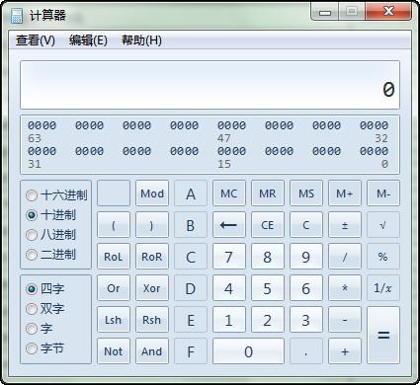
Principle of Testing
Axiom 1 It is impossible to test a program completely
How many test cases do you need to exhaustively test:
Powerpoint
A calculator
MS Word
Any interesting software!
The only way to be absolutely sure software works is to run it against all possible inputs and observe all of its outputs …
Oh, and the specification must be correct and complete.

Slide 74
Principle of Testing
Axiom 1 (cont’d) It is impossible to test a program completely
The number of possible inputs is very large.
The number of possible outputs is very large.
The number of paths through the software is very large.
The software specification open to interpretation.

Slide 75
Principle of Testing
Axiom 2 Software testing is a risk-based exercise
If you do not test the software for all inputs (a wise choice) you take a risk.
Hopefully you will skip a lot of inputs that work correctly.
What if you skip inputs that cause a fault?
Risk: financial loss, security, loss of money, loss of life!
That is a lot of pressure for a tester!
This course is all about techniques and practices to help reduce the risk without breaking the bank.

Slide 76
Principle of Testing
Axiom 2 (cont’d) Software testing is a risk-based exercise
If you try to test too much, the development cost becomes prohibitive.
If you test too little, the probability of software failure increases and as we discussed … software failures can cost us big time!
Number of
Missed Bugs
Cost of
Testing
Quantity
Under
Testing
Testing
Equilibrium
Over
Testing
Amount of Testing

Slide 77
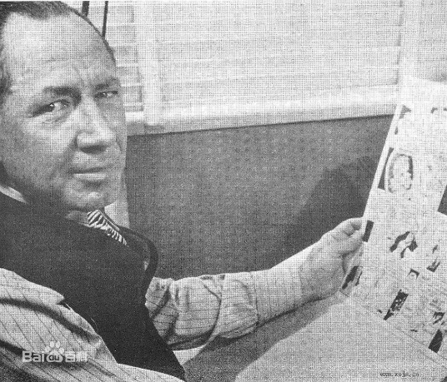
Principle of Testing
Axiom 2 (cont’d) Software testing is a risk-based exercise What about Murphy’s Law?
"If there's more than one possible outcome of a job or task, and one of those outcomes will result in disaster or an undesirable consequence, then somebody will do it that way.”
The law's name stems from an attempt to use new measurement devices developed by one Edward Murphy.
The phrase was coined in reaction to something Murphy said when his devices failed to perform and was eventually cast into its present form prior to a press conference months later.

Slide 78

Principle of Testing
Axiom 3 Testing cannot show the absence of bugs
“Program testing can be used to show the presence of bugs, but never to show their absence!” - Edsger Wybe Dijkstra
Dijkstra received the 1972 ACM Turing Award for fundamental contributions in the area of programming languages

Slide 79

Principle of Testing
Axiom 4 The more bugs you find, the more bugs there are
Bugs appear in groups, where you see one you will likely find more … Why?
Programmers can have bad days
Programmers tend to make the same mistakes
Some bugs are just the tip of the iceberg.
Boris Beizer coined the term pesticide paradox to describe the phenomenon that the more you test software the more immune it becomes to your test cases.
Remedy: continually write new and different tests to exercise different parts of the software.

Slide 80
Principle of Testing
Axiom 5 Not all bugs found will be fixed
Why wouldn’t you fix a bug you knew about?
There’s not enough time
Some deadlines cannot be extended (e.g., Y2K)
It’s not really a bug
Specifications can be wrong
It’s too risky to fix
“I’m not touching Murphy’s code!”
It’s just not worth it
Bugs in fringe features may have to wait
Why not charge the customer for bug fixes in the next release (sound familiar?) :-)

Slide 81
Principle of Testing
Axiom 6 It is difficult to say when a bug is indeed a bug
If there is a problem in the software but no one ever discovers it … is it a bug?
Parody of “if a tree falls in the forest … does it really make a noise?”
What is your opinion? Does a bug have to be observable in order for it to be a bug?
Bugs that are undiscovered are called latent bugs.

Slide 82
Principle of Testing
Axiom 7 Specifications are never final
Building a product based on a “moving target” specification is fairly unique to software development.
Competition is fierce
Very rapid release cycles
Software is “easy” to change
Not true in other engineering domains
E.g., the Brooklyn Bridge could not be adjusted to allow train traffic to cross it once its construction started.

Slide 83
Principle of Testing
Axiom 8 Software testers are not the most popular members of a project
Goal of a software tester:
Find bugs
Find bugs early
Make sure bugs get fixed
Tips to avoid becoming unpopular:
Find bugs early
Temper your enthusiasm … act in a professional manner
Don’t report just the bad news

Slide 84
Principle of Testing
Axiom 9 Software testing is a disciplined and technical profession
When software was simpler and more manageable software testers were often untrained and testing was not done methodically.
Contrary to the urban legend, if you hire a million moneys and have them test for a million years … you will not find all of the bugs in your software.
It is now too costly to build buggy software.
As a result testing has matured as a discipline.
Sophisticated techniques
Tool support
Rewarding careers

Slide 85
Principle of Testing
Some Terminology
Verification
“Are we building the product right?”
Does the software meet the specification?
Validation
“Are we building the right product?”
Does the software meet the user requirements?
Software Quality Assurance
Not the same as software testing …
Create and enforce standards and methods to improve the development process and to prevent bugs from occurring.

Slide 86
Principle of Testing
You now know …
… the 9 axioms of software testing
… what is software verification
… what is software validation
… the relationship between software quality and reliability
… the relationship between testing and quality assurance

Slide 87
Chapter 3 White Box Testing (Week 4-5)

Slide 88
16 Weeks Plan
Week 1: The basic concepts and theories of testing
Week 2-3: Principles of Testing
Week 4-5: White Box Testing
Week 6-7: Test Cases & Black Box Testing
Week 8: Usability Testing
Week 9: Mutation Testing & Finite Automata
Week 10: Mid-term Review and System Testing
Week 11: Empirical Software Testing
Week 12: Interaction System Testing
Week 13-14: ML & AI System Testing
Week 15-16: Conclusion & General Review

Slide 89
TESTING FUNDAMENTALS EXAMINING THE CODE

Slide 90

Examine the Design Documents & Code
These are static, white box techniques.
Handling these requires some programming expertise.
It is best if the testers know the language in which the software is written.
Consequently, you often find these tests are run by either Programmers with software testers as observers or Software testers with help from the programmers.

Slide 91
Major Problems with These Tests
They are often NOT performed!
These are the hardest to justify to upper management as they are viewed by many as too time consuming.
Some of the problem is the perception that programmers are not productive if they are not generating code.
Note: The tyranny of the LOC metric, Lines of executable code as a measure of productivity!

Slide 92
Three approaches
Formal inspection
Peer review
Walkthrough
Informal
Formal
Peer desk check Walkthrough Inspection

Slide 93
FORMAL REVIEWS
These are structured processes for doing static, white box testing.
4 elements are required:
1. Identify problems by directing attention to the code, not who wrote it.
2. Setup and follow rules for the review:
- How much code should be examined?
- How long should the review take?
- What is fair game for the review?
3. Prepare and assign duties to people
Moderator, recorder, reader, etc.
4. Write a report.
These are not just “get together and go over code” sessions!

Slide 94

Formal Reviews - Formal inspection
1. Well-defined roles and responsibilities
2. Well-defined steps
Overview
Preparation
Inspection
Rework
Meeting
Follow-up

Slide 95
Typically, different levels of formality identify the kind of formal review:
Peer (or Buddy) Review:
Most informal.
Involves a coder and a few buddies.
Still be sure all 4 elements are present.
Walkthroughs:
Next step in formality.
The programmer works with a small group of ~5 programmers and testers.
Everyone has copies of the code in advance.
A presenter “reads” the code line-by-line, function by function, saying what is done and why it is being done.

Slide 96
Example in a Walkthrough
Consider
for (i = 1; i < n; i++)
cout << a[i] << endl;
cout << i << endl;
Reader explains
That i is the index of an array named a.
The variable n is initialized elsewhere (and identifies where).
The loop outputs values for a[1], a[2], ..., a[i-1].
Questions raised:
Where does the variable i get a value for the last line?
Does the programmer expect the output value for i to be inside the loop?

Slide 97
Inspections
Most formal of the reviews.
Very highly structured.
The agenda and code to consider is available in advance of the meeting.
The presenter or reader isn’t one of the programmers.
All the other people are inspectors playing different roles. Examples are
- User
- Tester
- Product support person
- Have a moderator and a recorder.

Slide 98
Goal of All of the Formal Reviews
Look for problems and omissions in the code.
May check also to see if the code is written to adhere to pre-specified standards or guidelines.
There is a lot of literature on how formal reviews should be conducted.
Most companies that use them develop their own checklists.

Slide 99
Standards and Guidelines
Be careful not confuse these with style considerations.
Indenting rules are about style, not something that affects whether a program is correct or not.
Examples of standards or guidelines:
- Don’t use GOTOs
- Use WHILE loops, instead of DO-WHILE loops except in rare cases.

Slide 100
Examples
Visual Basic Coding Standards by Phil Fresle
Copyright 2000 Frez Systems Limited
Last updated 17-Apr-2000
Introduction Naming Conventions Use of Variables, Procedures and Constants Commenting Code Formatting Code Other Coding Rules Sample Boilerplates Sample Code Containing Error Handling Further Reading
Introduction
These are the Visual Basic coding standards used by Frez Systems Limited.

Slide 101
Another Example
1. Foreword
2. Release Note
3. Commentary in file
4. Constant
5. Variable
6. Struct/Enum definition
7. Expression and code blocks
8. Some good habit

Slide 102
Why Use Standards or Guidelines
Studies show they increase
Reliability
Readability and, hence, maintainability
Portability
Some contractors require that certain standards be used when developing software for them.
Good example- the government

Slide 103
Organizations Producing Various Standards and Guidelines
ANSI – American National Standards Institute
IEC – International Engineering Consortium
ISO – International Organization for Standardization
NCITS – National Committee for Information Technology Standards
Plus various professional organizations
ACM – Association for Computing Machinery
IEEE – Institute of Electrical and Electronic Engineering
Plus some of the testing organizations which we will consider later produce some standards for testing processes.

Slide 104
One list to check while doing formal reviews (from the text) :
Data reference errors.
Data declaration errors.
Computation errors.
Comparison errors.
Control flow errors.
Subroutine (or function) parameter errors.
I/O errors
Miscellaneous

Slide 105
TESTING FUNDAMENTALS
TESTING THE SOFTWARE
WITH X-RAY GLASSES

Slide 106
Test thoroughness
Test code thoroughly, one of several approaches based on data manipulated by the code:
Statement testing: every statement is executed at least once in some test
Branch testing
Path testing
Definition-use path testing
All uses testing
Statement, Path, Use

Slide 107
Examples
Pointer=False
1
Paths:
1-2-3-4-5-6-7
1-2-3-4-5-6-1
1-2-4-5-6-7
1-2-4-5-6-1
2
X>K?
Yes
Pointer = True
3
No
X=X+1
4
Call Sub (x, pointer, result)
5
6
Result>0?
Yes
Print result
7
No

Slide 108
Dynamic, White Box Testing
What many people think of when you mention testing.
But, note all the other possibilities we have already examined.
Control Flow Testing also called structural testing.
Control-flow testing techniques are based on judiciously selecting a set of test paths through the program.
The set of paths chosen is used to achieve a certain measure of testing thoroughness.
E.g., pick enough paths to assure that every source statement is executed as least once.
Techniques here are not limited to just examining the code, but involve directly controlling the software.

Slide 109
Overview of the Areas of Dynamic, White Box Testing
Directly test the pieces--- the low-level functions, procedures, subroutines or libraries.
Do top level testing of the completed program, but choose test cases by knowledge of the code.
Directly access variables and state information and force the software to do things.
Measure how much of the code has been tested and be able to adjust your tests to remove redundant test cases and add missing ones.
CAUTION: Be careful to not confuse testing with debugging!
When you try to correct bugs, you are debugging. Normally, programmers debug.

Slide 110
Debugging plays a role
We see this even with compiler errors.
Consequently, testing requires that debugging be done quickly after some bugs are found.
Remember, the earlier a bug is found, the cheaper it is to fix. Bugs often mask other bugs
Always remember that creating black-box test cases based on specs is important as these expose misinterpreted ideas, which can’t be found by white-box testing.
Dynamic
White-box
Testing
Debugging
Isolating
the bug
Testing
Programming

Slide 111
White-Box Testing
Basic Path Testing
exercise each independent path at least once
Condition Testing
exercise all logical conditions on their true and false sides
Loop Testing
execute all loops at their boundaries and within their bounds
Data Flow Testing
exercise all data structures to ensure their validity

Slide 112
Basic Path Testing
Goal: exercise each independent path at least once.
Using the code, draw a corresponding flow graph (First drawing the activity diagram for the code may help, but is not required)
Determine the cyclomatic complexity of the flow graph.
Determine a basis set of linearly independent paths.
Prepare test cases that force the execution of each path in the basis set.

Slide 113
Flow graph from code
Flow graphs Consist of Three Primitives
A decision is a program point at which the control can diverge.
(e.g., if and case statements).
A junction is a program point where the control flow can merge.
(e.g., end if, end loop, goto label)
A process block is a sequence of program statements uninterrupted by either decisions or junctions. (i.e., straight-line code).
A process has one entry and one exit.
A program does not jump into or out of a process.

Slide 114
Flow graph from code
.
.
.
Sequence
If-then-else
Case
Do-until
Do-while

Slide 115
Binary search (Java)

Slide 116
Binary search flow graph

Slide 117
Basis path test
A path through a program is a sequence of statements that starts at an entry, junction, or decision and ends at another (possible the same), junction, decision, or exit.
A path may go through several junctions, processes, or decisions, one or more times.
Paths consist of segments.
The smallest segment is a link. A link is a single process that lies between 2 nodes.
The length of a path is the number of links in a path.
An entry/exit path or a complete path is a path that starts at a routine’s entry and ends at the same routine’s exit.
1
2
3
4

Slide 118
Basis path test
Complete paths are useful for testing because:
It is difficult to set up and execute paths that start at an arbitrary statement.
It is difficult to stop at an arbitrary statement without changing the code being tested.
We think of routines as input/output paths.
Path Selection Criteria
There are many paths between the entry and exit points of a typical routine.
Even a small routine can have a large number of paths.

Slide 119
Example
Procedure: process records
1. Do While records remain
2. Read record;
3. If record field 1 = 0 Then
4. store in buffer;
5. increment counter;
6. Else If record field 2 = 0 Then
7. reset counter;
8. Else store in file;
9. End If
10. End If
11. End Do
End

Slide 120
Example (continued)
Procedure: process records
1. Do While records remain
2. Read record;
3. If record field 1 = 0 Then
4. store in buffer;
5. increment counter;
6. Else If record field 2 = 0 Then
7. reset counter;
8. Else store in file;
9. End If
10. End If
11. End Do
End
1
2
3
6
4
8
7
9
5
10
11
V(G) = 4

Slide 121
Basis path test example: FLOW GRAPH
1
2,3
6
4,5
8
7
9
10
11

Slide 122
Determine cyclomatic complexity of flow graph
Cyclomatic complexity: a quantitative measure of the logical complexity of code, provides an upper bound on the number of paths that need to be tested in the code
modules
Higher Cycloramic Complexity, more possibility in error
V(G)
modules in this range are more error prone
V(G) =number of regions (areas bounded by nodes and edges—area outside the graph is also a region)
V(G) = number of edges - the number of nodes + 2
V(G) = number of (simple) predicate nodes + 1
Notes:
2. Determine the cyclomatic complexity of the resultant flow graph
Note: can be determined without developing a flow graph
count all conditional statements in a component
→ compound conditions count as 2
(number of Boolean operators + 2)

Slide 123
Basis path test example : FLOW GRAPH
1
Region 1
Region 4
2,3
6
4,5
Region 2
7
Region 3
8
9
10
V(G)=4
11

Slide 124
Determine a basis set of linearly independent paths
Independent path ® any path that introduces at least one new set of processing statements or a new condition
Basis set ® set of independent paths through the code
Test cases derived from a basis set are guaranteed to execute every statement at least one time during testing
Basis set is not unique
Notes:
3. Determine a basis set of linearly independent paths
equal to cyclomatic complexity number
identify predicate nodes as an aid in derivation of test cases

Slide 125
Basis path test example
Path1: 1-2-3-6-7-9-10-1-11
1
2
Path2: 1-2-3-6-8-9-10-1-11
3
6
4
Path3: 1-2-3-4-5-10-1-11
7
8
9
5
11
10
Path4: 1-11

Slide 126
Basis path test example
1 scanf(“%d %d”,&x, &y);
2 if (y < 0)
3 pow = -y;
4 else
5 pow = y;
6 z = 1.0;
7 while (pow != 0) {
8 z = z * x;
9 pow = pow - 1;
10 }
11 if (y < 0)
12 z = 1.0 / z;
13 printf (“%f”,z);

Slide 127
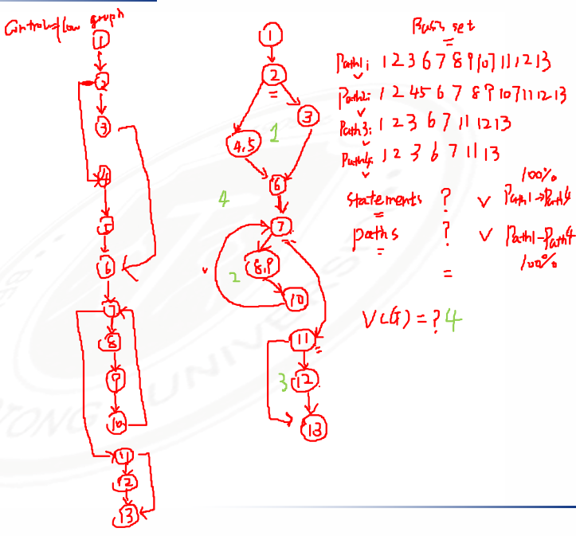
Review: Basis path test example
1 scanf(“%d %d”,&x, &y);
2 if (y < 0)
3 pow = -y;
4 else
5 pow = y;
6 z = 1.0;
7 while (pow != 0) {
8 z = z * x;
9 pow = pow - 1;
10 }
11 if (y < 0)
12 z = 1.0 / z;
13 printf (“%f”,z);

Slide 128
Basis path test example
for (j=1; j<N; j++)
{
3 last = N - j + 1;
4 for (k=1; k<last; k++)
5 {
6 if (list[k] > list[k+1])
7 {
8 temp = list[k];
9 list[k] = list[k+1];
10 list[k+1] = temp;
11 }
12 }
13 }
14 print(“Done\n”);

Slide 129
Basis path test example
for (j=1; j<N; j++)
{
3 last = N - j + 1;
4 for (k=1; k<last; k++)
5 {
6 if (list[k] > list[k+1])
7 {
8 temp = list[k];
9 list[k] = list[k+1];
10 list[k+1] = temp;
11 }
12 }
13 }
14 print(“Done\n”);

Slide 130
Basis path test example
1 main(int argc, char *argv[])
2 {
3 int numChars = 0;
4 int numLines = 0;
5 char chr;
6 FILE *fp = NULL;
7
8 if (argc < 2)
9 {
10 printf(“\nUsage: %s <filename>”, argv[0]);
11 return (-1);
12 }
13 fp = fopen(argv[1], “r”);
14 if (fp == NULL)
15 {
16 perror(argv[1]); /* display error message */
17 return (-2);
18 }
19 while (!feof(fp))
20 {
21 chr = getc(fp); /* read character */
22 if (chr == ‘\n’) /* if carriage return */
23 ++numLines;
24 else
25 ++numChars;
26 }
27 printf(“\nNumber of characters = %d”, numChars);
28 printf(“\nNumber of lines = %d”, numLines);
29 }

Slide 131
Basis path test example
/* COUNT
This program counts the number of characters and lines in a text file.
INPUT: Text File
OUTPUT: Number of characters and number of lines.
*/
1 main(int argc, char *argv[])
2 {
3 int numChars = 0;
4 int numLines = 0;
5 char chr;
6 FILE *fp = NULL;
7
8 if (argc < 2)
9 {
10 printf(“\nUsage: %s <filename>”, argv[0]);
11 return (-1);
12 }
13 fp = fopen(argv[1], “r”);
14 if (fp == NULL)
15 {
16 perror(argv[1]); /* display error message */
17 return (-2);
18 }
19 while (!feof(fp))
20 {
21 chr = getc(fp); /* read character */
22 if (chr == ‘\n’) /* if carriage return */
23 ++numLines;
24 else
25 ++numChars;
26 }
27 printf(“\nNumber of characters = %d”, numChars);
28 printf(“\nNumber of lines = %d”, numLines);
29 }

Slide 132
Basis path test example
1. function radixSort(arr, maxDigit) {
2. varmod = 10;
3. vardev = 1;
4. for(vari = 0; i < maxDigit; i++, dev *= 10, mod *= 10) {
5. for(varj = 0; j < arr.length; j++) {
6. varbucket = parseInt((arr[j] % mod) / dev);
7. if(counter[bucket]==null) {
8. counter[bucket] = [];
9. }
10. counter[bucket].push(arr[j]);
11. }
12. varpos = 0;
13. for(varj = 0; j < counter.length; j++) {
14. varvalue =null;
15. if(counter[j]!=null) {
16. while((value = counter[j].shift()) !=null) {
17. arr[pos++] = value;
18. }
19. }
20. }
21. }
22. return arr;
23. }

Slide 133
Test cases to execute each path in the basis set
you do not need an activity diagram, but the picture will help when you trace component paths
count each logical test—compound tests count as the number of Boolean operators + 1 (i.e., count each simple predicate)
basis path testing should be applied to all components, if possible, and to critical components always
Basis path testing does not test all possible combinations of all paths through the code; it just tests every path at least once.
Notes:
4. Prepare test cases that will force execution of each path in the basis set
each test case is executed and compared to the expected result
this process can be mechanized

Slide 134
Condition testing
Goal: further exercises the true and false value of each simple logical condition in a component.
Logical conditions
Simple condition: (a rel-op b) where rel-op={<, ≤, =, ≠, ≥, >} (may be negated with NOT), e.g., a≤b; NOT(a≤b)
Compound condition: two or more simple conditions connected with AND, OR, e.g., (a>b) AND (c<d)
Relational expression: (E₁ rel-op E₂) where E₁ and E₂ are arithmetic expressions, e.g., ((a*b+c)>(a+b+c))
errors to test for include (incorrect/missing/extra):
Boolean operator – relational operator
Boolean variable – arithmetic expression
Boolean parenthesis

Slide 135
Condition testing (2)
Branch testing
for a compound condition C, test true and false branches of C and every simple condition of C
e.g., for C = (a>b) AND (c<d) test:
a>b TRUE, FALSE
c<d TRUE, FALSE
C TRUE, FALSE
True AND True
T. And F., F. And T.,
F. And F.
Domain testing
for an expression E₁ rel-op E₂, test for E₁ ≧ ≦ = < > ≠ E₂
guarantees detection of rel-op error if E₁ and E₂ are correct
to detect errors in E₁ / E₂, the difference between E₁ and E₂ for the tests E₁ < or > than E₂ should be as small as possible
for an expression with n variables, 2^{n} tests are required

Slide 136
Condition Testing-Example
start
But ( i = result = 0 ) :
maxint N i<N result<=maxint
-1 1 true false
1 0 false true
gives condition coverage for all conditions
N < 0
yes
N := -N;
no
i:=i+1;
result:=result+i;
(i<N) and
(result<=maxint)
yes
But it does not preserve decision coverage ⇓
always take care that condition coverage preserves decision coverage :
decision / condition coverage
no
yes
no
result<=maxint
output(result);
output(too large);
exit

Slide 137
Branch Testing
Branch Coverage
Execute the enough test cases，attempting to cover all the paths in the software:
- Get both “True” and “False”
- Go through each branch。
For example
IF b THEN s1 ELSE s2
CASE x OF 1 : …. 2 : …. 3 : ….

Slide 138
Branch Testing - Example
1 PROGRAM som ( maxint, N : INT )
2 INT result := 0 ; i := 0 ;
3 IF N < 0
4 THEN N := - N ;
5 WHILE ( i < N ) AND ( result <= maxint )
6 DO i := i + 1 ;
7 result := result + i ;
8 OD;
9 IF result <= maxint
10 THEN OUTPUT ( result )
11 ELSE OUTPUT ( “too large” )
12 END.

Slide 139
Branch Testing - continued
start
Tests for complete statement coverage: maxint N
10 -1
0 -1
is not sufficient for branch coverage;
result=0 i=0
N < 0
yes
N < 0
N := -N;
no
(N>=0)
i:=i+1;
result:=result+i;
(i<N) and
(result<=maxint)
yes
Take:
maxint N
10 3
0 -1
for complete branch coverage
no
yes
result<=maxint
no
output(result);
output(too large);
exit

Slide 140
Control Flow Testing
How do we define “complete” testing?
1) Exercise every path from entry to exit.
2) Exercise every statement at least once.
3) Exercise every branch (in each direction) at least once.
Clearly, 1 implies 2 and 3
However, 1 is impractical for most routines.
Also, 2 is not equal to 3 in languages with goto statements.

Slide 141
Control Flow Testing
Demonstration that 2 does not imply 3
Correct Code
1 if (x >= 0 ) {
x = x + A;
}
2 x = x + A
2.Statement Coverage: For x < 0 the program produces the correct result AND every statement has been executed.
3.Branch Coverage:
Would have found the bug! Therefore 2 does not imply 3.
1
2
Buggy Code
1 if (x >= 0 ) {
/* missing statement */
}
2 x = x + A

Slide 142
Control Flow Testing
Demonstration that 3 Does not Imply 2
1 if (x < 0) {
2 goto 200;
x = x + A
} else
x = x + B
3 200: x = x + C
Branch Coverage: Does not exercise dead code. Therefore 3 does not imply 2.
However, 3 implies 2 for programs written in a structured programming language without goto statements.
1
2
3

Slide 143
Control Flow Testing
Control-flow Testing Criteria
We have explored 3 testing criteria from an infinite set of strategies:
1) Path Testing ( ):
100% path coverage.
Execute all possible control flow paths through the program.

Slide 144
Control Flow Testing
Control-flow Testing Criteria (Cont’d)
2) Statement Testing ( ):
100% statement coverage.
Execute all statements in a program at least once under some test.
3) Branch Testing ( ):
100% branch coverage.
Execute enough tests to assure that every branch alternative has been exercised at least once under some test.

Slide 145
Data Flow Testing

Slide 146
Data Flow
Beyond structure
Goal: Try to ensure that values are computed and used correctly
1
2
3
4
5
6
7
8

Slide 147
Data Flow
Definition (def) : A location where a value for a variable is stored into memory
Use : A location where a variable’s value is accessed
Z = X*2
Defs: def (1) = {X}
def (5) = {Z}
def (6) = {Z}
Uses: use (5) = {X}
use (6) = {X}
X = 42
2
5
1
4
7
3
6
Z = X-8
The values given in defs should reach at least one, some, or all possible uses

Slide 148
Define and Use
(def) Defined Objects
An object (e.g., variable) is defined when it:
appears in a data declaration
is assigned a new value
is a file that has been opened
is dynamically allocated
...
(use) Used Objects
An object is used when it is part of a computation or a predicate.
A variable is used for a computation (c) when it appears on the RHS (Right Hand Side) of an assignment statement.
A variable is used in a predicate (p) when it appears directly in that predicate.

Slide 149
Sets of Def and Use
def (n) or def (e) : The set of variables that are defined by node n or edge e
use (n) or use (e) : The set of variables that are used by node n or edge e
DU pair : A pair of locations (l_{i}, l_{j}) such that a variable v is defined at l_{i} and used at l_{j}
Def-clear : A path from l_{i} to l_{j} is def-clear with respect to variable v if v is not given another value on any of the nodes or edges in the path
Reach : If there is a def-clear path from l_{i} to l_{j} with respect to v, the def of v at l_{i} reaches the use at l_{j}

Slide 150
DU Path
du-path : A simple subpath that is def-clear with respect to v from a def of v to a use of v
du (n_{i}, n_{j}, v) the set of du-paths from n_{i} to n_{j}
du (n_{i}, v) the set of du-paths that start at n_{i}

Slide 151
Data Flow Coverage Criteria
All-defs coverage (ADC) : For each set of du-paths S = du (n, v), TR contains at least one path d in S.
All-uses coverage (AUC) : For each set of du-paths to uses S = du (n_{i}, n_{j}, v), TR contains at least one path d in S.
All-du-paths coverage (ADUPC) : For each set S = du (n_{i}, n_{j}, v), TR contains every path d in S.

Slide 152
Data Flow Testing
Z = X*2
X = 42
2
5
1
4
7
3
6
Z = X-8
All-defs for X
[ 1, 2, 4, 5 ]
All-uses for X
[ 1, 2, 4, 5 ]
[ 1, 2, 4, 6 ]
All-du-paths for X
[ 1, 2, 4, 5 ]
[ 1, 3, 4, 5 ]
[ 1, 2, 4, 6 ]
[ 1, 3, 4, 6 ]

Slide 153
Data Flow Testing
Example 1 (If condition):
What are the All-defs, All-uses, All-du-Paths for the program below?
1: read (z)
2: x = 0
3: y = 0
4: if (z ≥ 0)
5: {
6: x = sqrt (z)
7: if (0 ≤ x && x ≤ 5)
8: y = f (x)
9: else
10: y = h (z)
11: }
12: y = g (x, y)
13: print (y)

Slide 154
Data Flow Testing
Example 2 (If + Loop):
What are the All-defs, All-uses, All-du-Paths for the program below?

Slide 155
Example 3 (If + For Loop):
What are the All-defs, All-uses, All-du-Paths for the program below?
1
2
3
4
5
6
7
8
9
10
11
12
13
14
15
16
17
18
19
20
public static void CSta (int [ ] numbers)
{
int length = numbers.length;
double var, mean, sum, varsum;
sum = 0.0;
for (int i = 0; i < length; i++)
{
sum += numbers [ i ];
}
mean = sum / length;
varsum = 0.0;
for (int i = 0; i < length; i++)
{
varsum = varsum + ((numbers [i] - mean) * (numbers [i] - mean));
}
var = varsum / ( length - 1.0 );
System.out.println ("length: " + length);
System.out.println ("mean: " + mean);
System.out.println ("variance: " + var);
}

Slide 156
Control Flow Graph
public static void CSta (int [ ] numbers)
{
int length = numbers.length;
double var, mean, sum, varsum;
sum = 0.0;
for (int i = 0; i < length; i++)
{
sum += numbers [ i ];
}
mean = sum / length;
varsum = 0.0;
for (int i = 0; i < length; i++)
{
varsum = varsum + ((numbers [i] - mean) * (numbers [i] - mean));
}
var = varsum / ( length - 1.0 );
System.out.println ("length: " + length);
System.out.println ("mean: " + mean);
System.out.println ("variance: " + var);
}
1
2
3
4
5
6
7
8

Slide 157
If we use less states ?
public static void CSta (int [ ] numbers)
{
int length = numbers.length;
double var, mean, sum, varsum;
sum = 0.0;
for (int i = 0; i < length; i++)
{
sum += numbers [ i ];
}
mean = sum / length;
varsum = 0.0;
for (int i = 0; i < length; i++)
{
varsum = varsum + ((numbers [i] - mean) * (numbers [i] - mean));
}
var = varsum / ( length - 1.0 );
System.out.println ("length: " + length);
System.out.println ("mean: " + mean);
System.out.println ("variance: " + var);
}
1
2
1
3
def (1) = { numbers, sum, length }
4
5
2
def (2) = { i }
6
7
3
use (3, 5) = { i, length }
8
use (3, 4) = { i, length }
4
5
def (5) = {mean, varsum, i }
use (5) = {length, sum }
def (4) = { sum, i }
use (4) = { sum, numbers, i }
6
use (6, 7) = { i, length }
use (6, 8) = { i, length }
7
8
def (7) = { varsum, i }
use (7) = { varsum, numbers, i, mean }
def (8) = { var}
use (8) = {varsum, length, mean, var}

Slide 158
Variable List of Nodes
Node | Def | Use
1 | { numbers, sum, length } | { numbers }
2 | { i }
3
4 | { sum, i } | { numbers, i, sum }
5 | {mean, varsum, i } | { numbers, length, sum }
6
7 | { varsum, i } | { varsum, numbers, i, mean }
8 | {var} | {length, mean, var}
1
2
3
4
5
6
7
8

Slide 159
Variable List of Edges
1
Edge | Use
(1, 2)
(2, 3)
(3, 4) | { i, length }
(4, 3)
(3, 5) | { i, length }
(5, 6)
(6, 7) | { i, length }
(7, 6)
(6, 8) | { i, length }
2
3
4
5
6
7
8

Slide 160
DU-Paths
1
def (1) = { numbers, sum, length }
variable | DU Pairs | DU Paths
numbers | (1, 4) (1, 5) (1, 7) | [ 1, 2, 3, 4 ] [ 1, 2, 3, 5 ] [ 1, 2, 3, 5, 6, 7 ]
length | (1, 5) (1, 8) (1, (3,4)) (1, (3,5)) (1, (6,7)) (1, (6,8)) | [ 1, 2, 3, 5 ] [ 1, 2, 3, 5, 6, 8 ] [ 1, 2, 3, 4 ] [ 1, 2, 3, 5 ] [ 1, 2, 3, 5, 6, 7 ] [ 1, 2, 3, 5, 6, 8 ]
var | (8, 8) | No path needed
sum | (1, 4) (1, 5) (4, 4) (4, 5) | [ 1, 2, 3, 4 ] [ 1, 2, 3, 5 ] [ 4, 3, 4 ] [ 4, 3, 5 ]
2
def (2) = { i }
3
use (3, 5) = { i, length }
use (3, 4) = { i, length }
4
5
def (5) = {mean, varsum, i }
use (5) = { numbers, length, sum }
def (4) = { sum, i }
use (4) = { sum, numbers, i }
6
use (6, 8) = { i, length }
use (6, 7) = { i, length }
7
8
def (7) = { varsum, i }
use (7) = { varsum, numbers, i, mean }
def (8) = { var}
use (8) = {length, mean, var}

Slide 161
DU-Paths
variable | DU Pairs | DU Paths
mean | (5, 7) (5, 8) | [ 5, 6, 7 ] [ 5, 6, 8 ]
varsum | (5, 7) (5, 8) (7, 7) (7, 8) | [ 5, 6, 7 ] [ 5, 6, 8 ] [ 7, 6, 7 ] [ 7, 6, 8 ]
i | (2, 4) (2, (3,4)) (2, (3,5)) (4, 4) (4, (3,4)) (4, (3,5)) (5, 7) (5, (6,7)) (5, (6,8)) (7, 7) (7, (6,7)) (7, (6,8)) | [ 2, 3, 4 ] [ 2, 3, 4 ] [ 2, 3, 5 ] [ 4, 3, 4 ] [ 4, 3, 4 ] [ 4, 3, 5 ] [ 5, 6, 7 ] [ 5, 6, 7 ] [ 5, 6, 8 ] [ 7, 6, 7 ] [ 7, 6, 7 ] [ 7, 6, 8 ]
1
def (1) = { numbers, sum, length }
2
def (2) = { i }
3
use (3, 5) = { i, length }
use (3, 4) = { i, length }
4
5
def (5) = {mean, varsum, i }
use (5) = { numbers, length, sum }
def (4) = { sum, i }
use (4) = { sum, numbers, i }
6
use (6, 8) = { i, length }
use (6, 7) = { i, length }
7
8
def (7) = { varsum, i }
use (7) = { varsum, numbers, i, mean }
def (8) = { var}
use (8) = {length, mean, var}

Slide 162
DU Paths
38 DU Paths, 12 unique ones
1
[ 1, 2, 3, 4 ]
[ 1, 2, 3, 5 ]
[ 1, 2, 3, 5, 6, 7 ]
[ 1, 2, 3, 5, 6, 8 ]
[ 2, 3, 4 ]
[ 2, 3, 5 ]
[ 4, 3, 4 ]
[ 4, 3, 5 ]
[ 5, 6, 7 ]
[ 5, 6, 8 ]
[ 7, 6, 7 ]
[ 7, 6, 8 ]
2
3
4 expect a loop not to be “entered”
4
5
6 require at least one iteration of a loop
6
2 require at least two iterations of a loop
7
8

Slide 163
Test and Test Paths
One iteration of a loop
Test: numbers = (44)
Test Path: [ 1, 2, 3, 4, 3, 5, 6, 7, 6, 8 ]
DU Paths
[ 1, 2, 3, 4 ] [ 2, 3, 4 ] [ 4, 3, 5 ] [ 5, 6, 7 ] [ 7, 6, 8 ]
1
2
Two iterations of a loop
Test: numbers = (2, 10, 15) ; length = 3
Test Path: [ 1, 2, 3, 4, 3, 4, 3, 4, 3, 5, 6, 7, 6, 7, 6, 7, 6, 8 ]
DU Paths
[ 4, 3, 4 ] [ 7, 6, 7 ]
3
4
5
a loop not to be “entered”
Reveal the bug in the statement
med = numbers [length / 2];
6
Bug
7
8

Slide 164
Exercise 2
1 void Merge(int a[], int left, int mid, int right)
2 {
3 int len = right - left + 1;
4 int *temp = new int[len];
5 int k = 0;
6 int j = mid + 1;
7 while (i <= mid && j <= right)
8 {
9 temp[k++] = a[i] <= a[j] ? a[i++] : a[j++];
10 }
11 while (i <= mid)
12 {
13 temp[k++] = a[i++];
14 }
15 while (j <= right)
16 {
17 temp[k++] = a[j++];
18 }
19 for (int k = 0; k < len; k++)
20 {
21 a[left++] = temp[k];
22 }
23 }

Slide 165
Chapter 4 Test Cases & Black Box Testing (Week 6-7)

Slide 166
16 Weeks Plan
Week 1: The basic concepts and theories of testing
Week 2-3: Principles of Testing
Week 4-5: White Box Testing
Week 6-7: Test Cases & Black Box Testing
Week 8: Usability Testing
Week 9: Mutation Testing & Finite Automata
Week 10: Mid-term Review and System Testing
Week 11: Empirical Software Testing
Week 12: Interaction System Testing
Week 13-14: ML & AI System Testing
Week 15-16: Conclusion & General Review

Slide 167
OVERVIEW OF CLASSIFYING TESTS
BLACK-BOX: No knowledge of the internal logic of the code is utilized. Tests are based on requirements and functionality.
WHITE-BOX: Tests are designed based on the internal logic of the code, code coverage considerations, and analysis of branches, paths, loops, and conditions
UNIT: Test at the function or module level. May require test drivers or test harnesses.
INCREMENTAL INTEGRATION: Continuous testing as new functionality is added. May need test drivers. Testing combined parts of an application to see if the parts function together properly.
REGRESSION: Re-testing after fixes or modifications of software or the environment.

Slide 168
TEST PHASES
COMPARISON: Compares weaknesses and strengths to competing products.
ALPHA: Testing when development is nearing completion; minor design changes may be required.
BETA: Development and testing viewed as completed and looking for final bugs and problems before final release.

Slide 169
CLASSIFYING TESTS
FUNCTIONAL: Black-box testing geared to check functional requirements of an application.
SYSTEM: Black-box testing that is based on overall requirements and specifications.
STRESS: Often used interchangeably with ‘load’ and ‘performance’. But, others believe tests should check functionality under extreme conditions.
PERFORMANCE: Often used interchangeably with “load” and ‘stress’.
LOAD: Test under heavy loads to determine at what point a system’s response time degrades or fails
END-TO-END: Testing that mimics real-world use.

Slide 170
CLASSIFYING TESTS (continued)
ACCEPTANCE: Final testing based on specifications of the end-user or customer.
USABILITY: Testing for “user-friendliness”. This is clearly subjective and will depend on the targeted end-user or customer profile.
RECOVERY: How well can the system recover from crashes, hardware failures, or other catastrophic problems.
INSTALL/UNINSTALL: Test full, partial, or upgrade install/uninstall processes.
SECURITY: How well is the system able to protect against unauthorized internal or external access, willful damage, etc.
COMPATABILITY: How well does the software perform in a given hardware/software/operating system/network environment.

Slide 171
CLASSIFYING TESTS (summary)
By purposes • Correctness testing – Black-box – White-box • Performance testing • Reliability testing - Robustness/strong testing - Exception handling testing - Stress/load testing • Security testing | By life cycle phase • Requirements phase testing • Design phase testing • Program phase testing • Evaluating test results • Installation phase testing • Acceptance testing • Testing changes: maintenance | By scope • implied in – Unit testing – Component testing – Integration testing – System testing • or in – Unit testing – String testing – System testing (a test) – Acceptance testing (b test)

Slide 172
Unit test cases
Interface: ensures that information properly flows in and out of the component
local data structures: ensures that data stored temporarily maintains its integrity during execution
boundary conditions: ensures that the component operates properly at boundaries established to limit or restrict processing
independent paths: ensures that all paths in a component have been executed at least once
error-handling paths: ensures that errors are correctly handled

Slide 173
Two Approaches
Running
Running
Test Driver
Tested Module
=main()
call
Tested Module
Test Stub
a special-purpose program to simulate the activity of the missing component
Driver: component that calls component to be tested
Stub: component called by component to be tested

Slide 174
Unit test procedure
Driver
interface
local data structures
boundary conditions
independent paths
error-handling paths
Component
to be tested
Results
Test cases
Stub
Stub
driver and/or stubs must be developed for each unit test

Slide 175
Unit test procedure
public class unittest{
//Test driver
public static void main(String[] args) {
unittest d = new unittest();
d.Add();
}
//My module
public int Add() {
int output=this.Stub1() + this.Stub2();
System.out.print("My module: return value is "+output+"\n");
return output;
}
//Stub1 public int Stub1() {
int output=3;
System.out.print("Stub 1 : return value is "+output+"\n");
return output; }
//Stub2 public int Stub2() {
int output=7;
System.out.print("Stub 2 : return value is "+output+"\n");
return output; }
}

Slide 176
Methods in Unit test
1. Verify operation at normal parameter values
Verify operation at limit parameter values
3. Verify operation outside parameter values
Ensure that all instructions execute
5. Check all paths, including both sides of all branches
Check the use of all called objects
Verify the handling of all data structures
8. Verify the handling of all files

Slide 177
Methods in Unit test (2)
9. Check normal termination of all loops
10. Check abnormal termination of all loops
11. Check normal termination of all recursions (递归)
12. Check abnormal termination of all recursions
13. Verify the handling of all error conditions
14. Check timing and synchronization
15. Verify all hardware dependencies
Notes:
Recursion = 递归

Slide 178
OVERVIEW OF CLASSIFYING TESTS
BLACK-BOX: No knowledge of the internal logic of the code is utilized. Tests are based on requirements and functionality.
WHITE-BOX: Tests are designed based on the internal logic of the code, code coverage considerations, and analysis of branches, paths, loops, and conditions
UNIT: Test at the function or module level. May require test drivers or test harnesses.
INCREMENTAL INTEGRATION: Continuous testing as new functionality is added. May need test drivers. Testing combined parts of an application to see if the parts function together properly.
REGRESSION: Re-testing after fixes or modifications of software or the environment.

Slide 179
TEST PHASES
COMPARISON: Compares weaknesses and strengths to competing products.
ALPHA: Testing when development is nearing completion; minor design changes may be required.
BETA: Development and testing viewed as completed and looking for final bugs and problems before final release.

Slide 180
CLASSIFYING TESTS
FUNCTIONAL: Black-box testing geared to check functional requirements of an application.
SYSTEM: Black-box testing that is based on overall requirements and specifications.
STRESS: Often used interchangeably with ‘load’ and ‘performance’. But, others believe tests should check functionality under extreme conditions.
PERFORMANCE: Often used interchangeably with “load” and ‘stress’.
LOAD: Test under heavy loads to determine at what point a system’s response time degrades or fails
END-TO-END: Testing that mimics real-world use.

Slide 181
CLASSIFYING TESTS (continued)
ACCEPTANCE: Final testing based on specifications of the end-user or customer.
USABILITY: Testing for “user-friendliness”. This is clearly subjective and will depend on the targeted end-user or customer profile.
RECOVERY: How well can the system recover from crashes, hardware failures, or other catastrophic problems.
INSTALL/UNINSTALL: Test full, partial, or upgrade install/uninstall processes.
SECURITY: How well is the system able to protect against unauthorized internal or external access, willful damage, etc.
COMPATABILITY: How well does the software perform in a given hardware/software/operating system/network environment.

Slide 182
CLASSIFYING TESTS (summary)
By purposes • Correctness testing – Black-box – White-box • Performance testing • Reliability testing - Robustness/strong testing - Exception handling testing - Stress/load testing • Security testing | By life cycle phase • Requirements phase testing • Design phase testing • Program phase testing • Evaluating test results • Installation phase testing • Acceptance testing • Testing changes: maintenance | By scope • implied in – Unit testing – Component testing – Integration testing – System testing • or in – Unit testing – String testing – System testing (a test) – Acceptance testing (b test)

Slide 183
Unit test cases
Interface: ensures that information properly flows in and out of the component
local data structures: ensures that data stored temporarily maintains its integrity during execution
boundary conditions: ensures that the component operates properly at boundaries established to limit or restrict processing
independent paths: ensures that all paths in a component have been executed at least once
error-handling paths: ensures that errors are correctly handled

Slide 184
Two Approaches
Running
Running
Test Driver
Tested Module
=main()
call
Tested Module
Test Stub
a special-purpose program to simulate the activity of the missing component
Driver: component that calls component to be tested
Stub: component called by component to be tested

Slide 185
Unit test procedure
Driver
interface
local data structures
boundary conditions
independent paths
error-handling paths
Component
to be tested
Results
Test cases
Stub
Stub
driver and/or stubs must be developed for each unit test

Slide 186
Unit test procedure
public class unittest{
//Test driver
public static void main(String[] args) {
unittest d = new unittest();
d.Add();
}
//My module
public int Add() {
int output=this.Stub1() + this.Stub2();
System.out.print("My module: return value is "+output+"\n");
return output;
}
//Stub1 public int Stub1() {
int output=3;
System.out.print("Stub 1 : return value is "+output+"\n");
return output; }
//Stub2 public int Stub2() {
int output=7;
System.out.print("Stub 2 : return value is "+output+"\n");
return output; }
}

Slide 187
Methods in Unit test
1. Verify operation at normal parameter values
Verify operation at limit parameter values
3. Verify operation outside parameter values
Ensure that all instructions execute
5. Check all paths, including both sides of all branches
Check the use of all called objects
Verify the handling of all data structures
8. Verify the handling of all files

Slide 188
Methods in Unit test (2)
9. Check normal termination of all loops
10. Check abnormal termination of all loops
11. Check normal termination of all recursions (递归)
12. Check abnormal termination of all recursions
13. Verify the handling of all error conditions
14. Check timing and synchronization
15. Verify all hardware dependencies
Notes:
Recursion = 递归

Slide 189
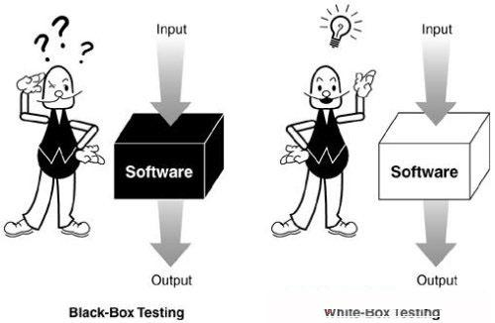
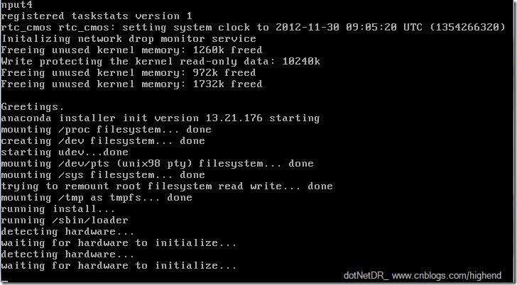
Design of Test Cases
Testing Techniques
Black Box Testing
White Box Testing
Static Testing
Dynamic Testing

Slide 190
Design of Test Cases
Black-box testing
Characteristics of Black-box testing:
Program is treated as a black box.
Implementation details do not matter.
Requires an end-user perspective.
Criteria are not precise.
Test planning can begin early.

Slide 191
Design of Test Cases
Dynamic black-box testing
Dynamic black-box testing is testing without having an insight into the details of the underlying code.
Dynamic, because the program is running
Black-box, because testing is done without knowledge of how the program is implemented.
Sometimes referred to as behavioral testing.
Requires an executable program and a specification (or at least a user manual).
Test cases are formulated as a set of pairs
E.g., (input, expected output)

Slide 192
Black-box Testing
Requirements
Output
B
Running SW
Given
Input A
Events

Slide 193
Black-box Testing
Test-to-pass and Test-to-fail
Test-to-pass:
assures that the software minimally works,
does not push the capabilities of the software,
applies simple and straightforward test cases,
does not try to “break” the program.
Test-to-fail:
designing and running test cases with the sole purpose of breaking the software.
strategically chosen test cases to probe for common weaknesses in the software.

Slide 194
Black-box Testing
Test Data and Test Cases
Test data: Inputs which have been devised to test the system.
Test cases: Inputs to test the system and the predicted outputs from these inputs if the system operates according to its specification.

Slide 195
Black-box Testing
Black-box testing

Slide 196
Black-box Testing
Obviously, we need something that defines the software--i.e. requirements document or specification document.
We must be able to specify what should be produced as output B, given input A.
We do NOT need to know HOW output B is produced from input A.
Although we can’t look at code, we may ask the programmers questions about numeric limits, internal quirks of the software etc.

Slide 197
Black-box Testing
Testing Methods in Black Box Testing
Random Testing
Equivalence Partitioning
Boundary Value Analysis
Cause Effect Analysis

Slide 198
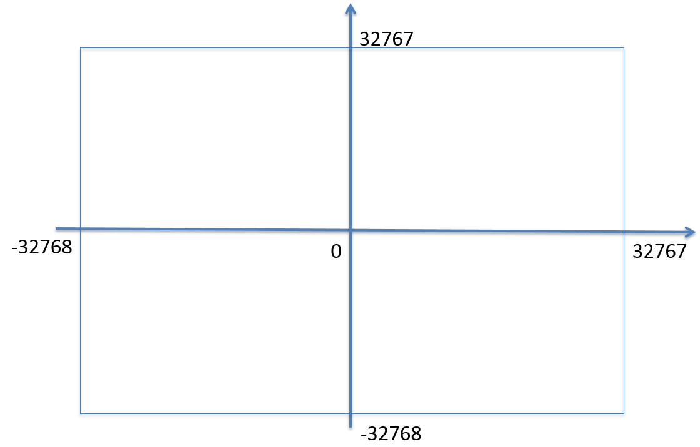
Random Testing
Test cases are generated purely at random [SWEBOK v3.0]
Input domain must be known
Pick random points within input domain
Automation
int Add(const int &a, const int &b)
{
return a+b;
}

Slide 199
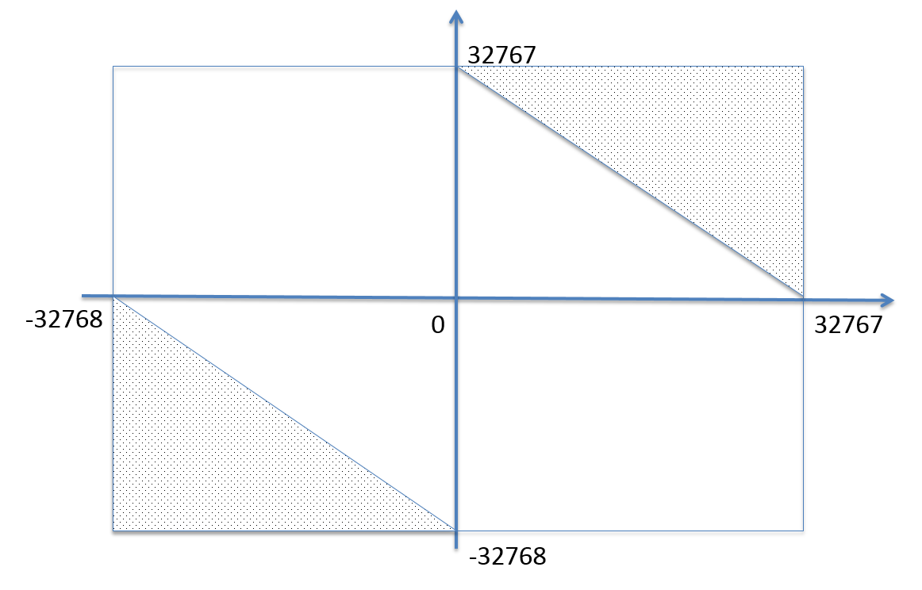
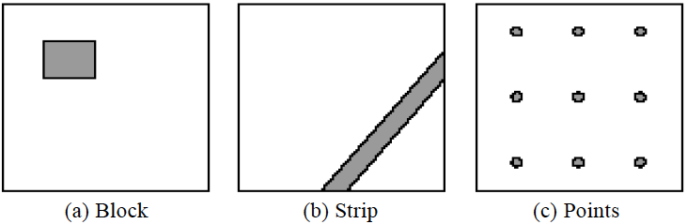
Adaptive Random Testing
int Add(const int &a, const int &b)
{
return a+b;
}
Typical patterns of failure-causing regions

Slide 200
Adaptive Random Testing
A passed test, nearby tests may be passed
A failed test, nearby tests may be failed
So, select test cases far away from others …

Slide 201
Black-box Testing
Testing Methods in Black Box Testing
Random Testing
Equivalence Partitioning
Boundary Value Analysis
Cause Effect Analysis

Slide 202
Define equivalence partitions - or classes
Equivalence partitioning helps us cut down the number of test cases without adding a great deal of risk.
Normally we look at two areas for testing:
- Data
- Logic flow
There are many guidelines for picking equivalence partitions.
Note: These are guidelines, not hard and fast rules.

Slide 203
Data Testing QUIDELINES FOR CHOOSING EQUIVALENCE CLASSES
Identify boundary conditions - data that is at the edge of the planned operational limits of the software.
For the boundaries, partition input into
- Valid data inside the boundary.
- Data just on the boundary (which may be valid or invalid).
- Invalid data just outside the boundary limits.
Boundary conditions should be identified in the requirements or the specifications.

Slide 204
Equivalence Partitioning 1
Idea is to partition the input space into a number of equivalence classes such that one could expect, based on the specification, that every element of a given class would be ‘‘handled’’ (i.e., mapped to
an output) in the same manner
(either correctly or incorrectly),
thus reducing the total number of test cases that must be developed.
Two types of classes are identified:
valid (corresponding to inputs deemed valid from the specification)
invalid (corresponding to inputs deemed erroneous from the specification)

Slide 205
Equivalence Partitioning 2
Divide all possible inputs into classes (partitions) such that : There is a finite number of input equivalence classes
You may reasonably assume that
The program behaves analogously for inputs in the same class
One test with a representative value from a class is sufficient
If the representative detects a fault, then other class members would detect the same fault
i₁
i₄
i₂
i₃
all inputs

Slide 206
Equivalence Classes
Valid data
User supplied commands.
Responses to system prompts.
File names.
Computational data:
Physical parameters,
Bounding values, and
Initiation values.
Output data formatting commands.
Responses to error messages.
Graphical data.
Invalid data
Data outside bounds of the program.
Physically impossible data.
Proper value supplied in wrong place.

Slide 207
Equivalence Classes Strategy
Identify input equivalence classes
Based on conditions on inputs/outputs in specification/description: Both valid and invalid input equivalence classes
Based on heuristics and experience :
“input x in [1..10]” → classes : x < 1, 1 ≤ x ≤ 10, x > 10
“enumeration A, B, C“ → classes : A, B, C, not{A,B,C,}
"input intege → classes : n not an integer, n < min, min ≤ n < 0, 0 ≤ n ≤ max, n > max
……
Define one/couple of test cases for each class
Test cases that cover valid classes
Test cases that cover at most one invalid class

Slide 208
Equivalence Partitioning Example 1
Partition system inputs into groups (partitions) that should cause
equivalent behaviour, include both valid and invalid inputs.
If input is a 5-digit integer between 10,000 and 99,999,
Equivalence partitions are:
< 10,000 10,000 - 99,999 > 99,999

Slide 209
Equivalence Partitioning Example 2
Identify (multiple sets of disjoint) equivalence classes for the following program specification fragment.
City Tax Specification:
1. If gross pay is no more than $30,000, the tax is 1%.
2. If gross pay is more than $30,000, but no more than $50,000, the tax is 5%.
3. If gross pay is more than $50,000, the tax is 15%.

Slide 210
Equivalence Partitioning 3
1. If input is a range, one valid and two invalid equivalence classes:
less than range
in range
greater than range
2. If input is a specific value, one valid and two invalid equivalence classes:
less than value
value
greater than value
3. If input is a set of related values, one valid and one invalid class:
not member of set
member of set
4. If input is Boolean, one valid and one invalid class:
nonBoolean
Boolean

Slide 211
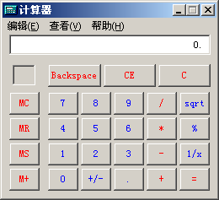
Equivalence Partitioning Example 3
Test for addition operation of MS calculator.
Class 1: Integer
Class 2: Decimal fraction
Class 3: Negative
Class 4: Invalid input

Slide 212
Further Partitioning Possibilities
Check default, empty, blank, null, zero, and no data.
- If nothing is entered, what happens?
- Default set?
- Error message?
- Hung program?
Check invalid, wrong, incorrect, and garbage data.
- Users WILL use the software incorrectly.
- Data loses or crashes are blamed on the software, always --- not the user
- Have fun with this one --- devious, tricky, and nasty are good traits for a tester!

Slide 213
Black-box Testing
Testing Methods in Black Box Testing
Random Testing
Equivalence Partitioning
Boundary Value Analysis
Cause Effect Analysis

Slide 214
Black-Box testing - Boundary Value Analysis (BVA)
A technique based on identifying, and generating test cases to explore boundary conditions.
Boundary conditions are an extremely rich source of errors.
Natural language based specifications of boundaries are often ambiguous, as in ‘‘for input values of X between 0 and 40,...’’
May be applied to both input and output conditions.
Also applicable to white box testing.
more errors occur at the boundaries of an input domain than in the “center”

Slide 215
Boundary Values
Based on experience / heuristics :
Testing boundary conditions of eq. classes is more effective i.e. values directly on, above, and beneath edges of classes
Choose input boundary values as tests in input classes instead of, or additional to arbitrary values
Choose also inputs that invoke output boundary values ( values on the boundary of output classes )
Example strategy as extension of equivalence partitioning:
choose one (n) arbitrary value(s) in each eq. class
choose values exactly on lower /upper boundaries of eq. class
choose values immediately below /above each boundary ( if applicable )

Slide 216
Guidelines for Identifying Boundary Values
1. If the input range is bounded by a and b, then use a, b, and values just above and just below a and b, respectively.
a
b
2. If the input is a number of values, use the minimum and maximum of the values and values just above and just below them, respectively.
a
b
3. Apply guidelines 1 and 2 to create output values at the minimum and maximum expected values.
4. If data structures have boundaries, test these boundary values and values just above and just below them, respectively.
e.g., for an array of bounds 1 to 10 — test array index equal to 0, 1,2, 9, 10, 11

Slide 217
BVA Example 1
Test a function for calculation of absolute value of an integer
Valid equivalence classes :
Condition Valid eq. classes Invalid eq. Classes
particular abs < 0, >= 0
Test cases :
class x < 0, arbitrary value: x = -10
class x >= 0, arbitrary value x = 100
classes x < 0, x >= 0, on boundary : x = 0
classes x < 0, x >= 0, below and above: x = -1, x = 1

Slide 218
BVA Example 2
Test a function which limit user input to 6-digit positive integer
Test cases :
Class arbitrary value: X1 = 123123
Class boundary value: X2 = 12345
Class boundary value: X3 = 1234567
Class boundary value: X4 = 1
Class boundary value: X5 = 0
Class invalid value: X6 = -123123
Class invalid value: X7 = asdasd
Others?
Class invalid value: X8 = 000123
X9 = asd123;
X10 = Empty

Slide 219
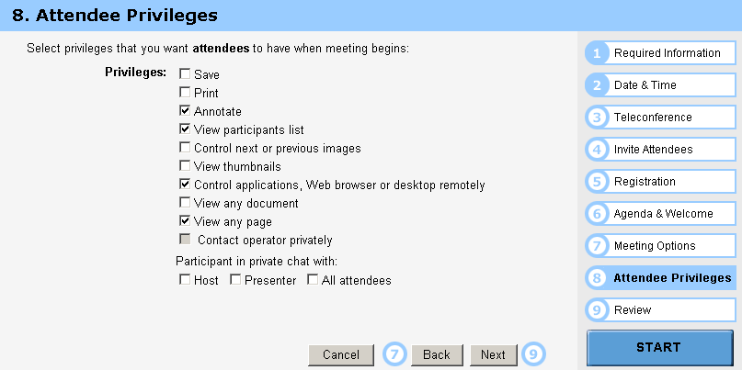
BVA Example 3
Test cases :
Class arbitrary value: Random select some options Class boundary value: Select all options Class boundary value: Select none option Class boundary value: Select 1 option

Slide 220
Other types in Boundary
First/last
Min/Max
Star/Finish
Empty/Full
Slower/Faster
Largest/Smallest
Over/Under
Shortest/Longest
… …
Numeric
Character
Position
Quantity
Speed
Location
Size

Slide 221
Examples of possible boundary conditions
Limits on input data – size, type
Limits on output data- size, type
Look for limits such as
First-1/Last+1
Start-1/Finish+1
Min-1/max+1
Less than empty/ more than full
just Over/Just Under
etc.
Don’t hesitate to choose data outside boundaries, even when it seems absurd.

Slide 222
Guidelines for choosing Equivalence classes For Data Testing
Identify sub-boundary conditions or internal boundary conditions
Some limits may not be apparent to the general end user.
To locate some of these, you may need to talk with programmers.
Example: Powers-of-two boundary conditions

Slide 223
Power-of-Two
Binary: 0 and 1, byte is made up of 8 bits, word is made up of 4 bytes, …
Term | Range or Value
Bit Nibble Byte Word Kilo Mega Giga Tera | 0 or 1 0-15 <Half byte> 0-255 0-65535 or 0-4294967295 1024 1048576 1073741824 1099511627776

Slide 224
EXAMPLE: Powers-of-Two
Often a programmer will handle data differently depending upon its size.
Example: Communications software where with limited bandwidth, we try to keep the size of data being transmitted low.
Program transmits 256 commands, but uses only a nibble (4 bits) to encode the 15 most commonly used commands.
Thus, there is an internal boundary between the 4th and 5th bit
Might try transmitting 3, 4, 5 bits in addition to ones determined by the stated boundary conditions of 1 and 8 bits.

Slide 225
An Example: A flight simulator
Assume the user can control the height of the plane, determine what those limits are:
Not specified?
Why not?
Nothing in a computer is infinite!
Try flying
Below ground
In outer space
Through a mountain (or some other object)

Slide 226
ASCII Table
Character | ASCII Value | Character | ASCII Value
Null Space / 0 1 2 9 ; @ A | 0 32 47 48 49 50 57 58 64 65 | B Y Z [ ‘ a b y z { | 66 89 90 91 96 97 98 121 122 123

Slide 227
ASCII Encoding Always Produce Sub-Boundary Conditions
The ASCII code is 8 bits.
If numeric digits are to be input,
check just out of range with the ‘/’ and ‘:’
If capital letters are to be input,
check just out of range with the ‘@’ and ‘[‘
If lower case letters are to be input,
check just out of range with the forward quote and the ‘{‘.
Character | ASCII Value | Character | ASCII Value
Null Space / 0 1 2 9 ; @ A | 0 32 47 48 49 50 57 58 64 65 | B Y Z [ ‘ a b y z { | 66 89 90 91 96 97 98 121 122 123
NOTE: The error in using the default settings in the PowerPoint software. In each case, I encased the character in a single quote--- i.e. the key below “.

Slide 228
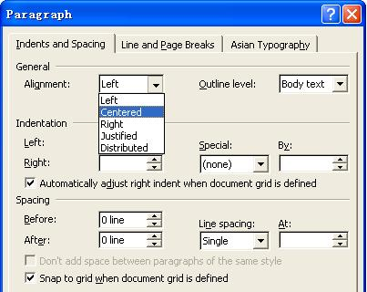
Text-box Field
Default
Empty
Blank
Null
Zero
None

Slide 229
Black-box Testing
Testing Methods in Black Box Testing
Random Testing
Equivalence Partitioning
Boundary Value Analysis
Cause Effect Analysis

Slide 230
Cause-Effect Analysis
Cause-Effect Analysis is a systematic means for generating test cases to cover different combinations of input ‘‘Causes’’ resulting in output ‘‘Effects.’’
A CAUSE may be thought of as a distinct input condition, or an ‘‘equivalence class’’ of input conditions.
An EFFECT may be thought of as a distinct output condition, or a meaningful change in program state.
Causes and Effects are represented as Boolean variables and the logical relationships among them CAN (but need not) be represented as one or more boolean graphs.

Slide 231
Cause-Effect Analysis Sample 1
Given inputs maxint and N compute result :
|N|
∑
result = if this <= maxint, error otherwise
k
K=0
Valid equivalence classes : condition valid eq. classes . abs(N) N < 0, N ≥ 0 maxint ∑ k ≤ maxint, ∑ k > maxint
Test Cases :
maxint N result maxint N result
55 10 55 100 0 0 54 10 error 100 -1 1 56 10 55 100 1 1 0 0 0 … … …

Slide 232
Cause-Effect Analysis 2
Systematic method for generating test cases representing combinations of conditions
Combinatorial explosion of number of possible combinations
Some heuristics to reduce this combinatorial explosion
Starting point is effects (outputs) then working ‘backwards’
‘light-weight’ formal methods: transformation into semi-formal Boolean graph
A technique : to be combined with others

Slide 233
Cause-Effect Analysis Sample 3
∑ k ≤ maxint
∑ k > maxint
N < 0
N ≥ 0
and
∑ k
error
and
xor
Causes ∑ k ≤ maxint 1 1 0 0
Inputs ∑ k > maxint 0 0 1 1
N < 0 1 0 1 0
N ≥ 0 0 1 0 1
Effects ∑ k 1 1 0 0
Outputs error 0 0 1 1

Slide 234
Cause-Effect Analysis 3
Black-box technique to analyze combinations of input conditions
Identify causes and effects in specification ↓ ↓ inputs outputs current state new state
Make Boolean Graph linking causes and effects
Annotate impossible combinations of causes and effects
Develop decision table from graph with in each column a particular combination of inputs and outputs
Transform each column into test case

Slide 235
C-E Analysis Process Steps
Cause-effect graphing consists of the following 4 steps
List and label causes (input-events) and effects (output actions) for a module
Draw a cause-effect graph describing the logical combinations of causes, intermediate causes and resulting effects,
Develop a decision table (causes vs effects) from the graph
Convert each row into a test case, or a set of rows into a testing scenario

Slide 236
Cause-Effect Analysis Sample 4
Case Matrix:
Cause
∑ k ≤ maxint
1
1
0
0
∑ k > maxint
0
0
1
1
N < 0
1
0
1
0
N ≥ 0
0
1
0
1
Effects
∑ k
1
1
0
0
error
0
0
1
1

Slide 237
Chapter 5 Unit Testing & System Testing (Week 8 & Week 10)

Slide 238
16 Weeks Plan
Week 1: The basic concepts and theories of testing
Week 2-3: Principles of Testing
Week 4-5: White Box Testing
Week 6-7: Test Cases & Black Box Testing
Week 8: Usability Testing
Week 9: Mutation Testing & Finite Automata
Week 10: Mid-term Review and System Testing
Week 11: Empirical Software Testing
Week 12: Interaction System Testing
Week 13-14: ML & AI System Testing
Week 15-16: Conclusion & General Review

Slide 239
Two Approaches
Running
Running
Test Driver
Tested Module
=main()
call
Tested Module
Test Stub
a special-purpose program to simulate the activity of the missing component
Driver: component that calls component to be tested
Stub: component called by component to be tested

Slide 240
Unit test procedure
Driver
interface
local data structures
boundary conditions
independent paths
error-handling paths
Component
to be tested
Results
Test cases
Stub
Stub
driver and/or stubs must be developed for each unit test

Slide 241
Unit test procedure
public class unittest{
//Test driver
public static void main(String[] args) {
unittest d = new unittest();
d.Add();
}
//My module
public int Add() {
int output=this.Stub1() + this.Stub2();
System.out.print("My module: return value is "+output+"\n");
return output;
}
//Stub1 public int Stub1() {
int output=3;
System.out.print("Stub 1 : return value is "+output+"\n");
return output; }
//Stub2 public int Stub2() {
int output=7;
System.out.print("Stub 2 : return value is "+output+"\n");
return output; }
}

Slide 242
Integration Testing
If components all work individually, why more testing?
Interaction errors cannot be uncovered by unit testing!
(e.g., interface misuse, interface misunderstanding, timing errors)
Integration approaches
Big Bang!!
Incremental
construction
strategy
Versus
Incremental
“builds”
Regression
testing

Slide 243
Unit Tests vs Integration Tests
Unit tests – Test the pieces of code- the modules (functions, subroutines, etc.)
Integration tests – Test the program or combinations of modules.
Both of these need to be done, but two different strategies are used typically:
Bottom-up Testing
Top-down testing
Note: Mixed strategies can be used, but it is best to consider these separately.

Slide 244
Bottom-up Testing vs Top-down Testing
Bottom-up testing
Test the units as they are completed.
Debug the units.
Integrate some of the units and test the integration.
Debug the integrated units.
Continue until ....???
Note: to test the integrated units, driver code (which later may be thrown away) must be written.

Slide 245
Bottom-up Integration
A
B
C
D
E
F
G
Test E
Test B,E,F
Test A,B,C,D,E,F,G
Test F
Test C
Test G
Test D,G

Slide 246
Pros & cons
Advantage:
- Popular approach
- Is useful when many of low-level components are general-purpose utility routines that are invoked often by others
- Integrated test by component driver
- Test data and test case are created easily
Disadvantage:
- Top-level components are usually the most important but the last to be tested
- Sometimes faults in the top levels reflect faults in design, obviously, these problems should be corrected ASAP
- It is difficult to test a system from bottom up when much of the system’s processing depends on timing

Slide 247
Bottom-up Testing vs Top-down Testing
Top-down Testing
Write a top function first, such as the main function.
Write stubs to handle calls to other functions.
A stub is code that sets variables that must be returned to the calling function and may only just print something such as “In Module A”.
Test and debug the top function.
Replace the stub with actual code.
Test and debug the stub with its calling function(s).
Repeat until ... ???

Slide 248
Top-down integration
A
B
C
D
E
F
G
Test A
Test A,B,C,D,E,F,G
Test A,B,C,D

Slide 249
Pros & cons
Advantage:
- The most important components can be tested early
- Apply to top-down design and code
- Driver programs are not needed in top-down testing
- Logic and structure is clear
Disadvantage:
- A very large number of stubs (a special-purpose program to simulate the activity of the missing component) may be required
- Testing each level’s component individually introduces another difficulty

Slide 250
Modified Top-down integration
A
B
C
D
E
F
G
Test B
Test E
Test A
Test C
Test A,B.C,D
Test F
Test A,B,C,D,E,F,G
Test D
Test G

Slide 251
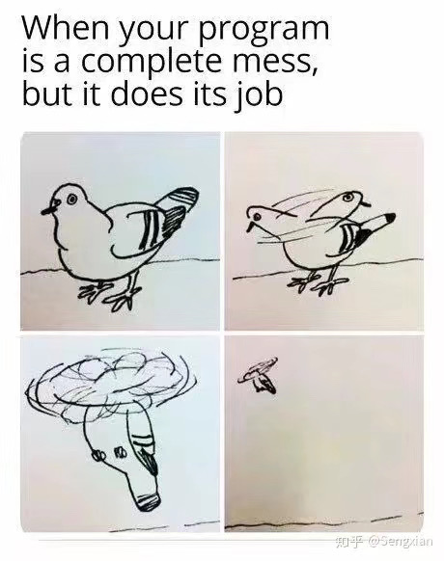
System Testing
Functional Behavior and Codes
Spec: The bird can fly…

Slide 252
System Testing
Topics in Testing Software
Usability

Slide 253
System Testing
Software Usability
Eventually a person will interact with a software system.
Software usability is how:
appropriate
functional
effective
that interaction is.
Ergonomics is the science of designing everyday things so that they are easy and functional to use.

Slide 254
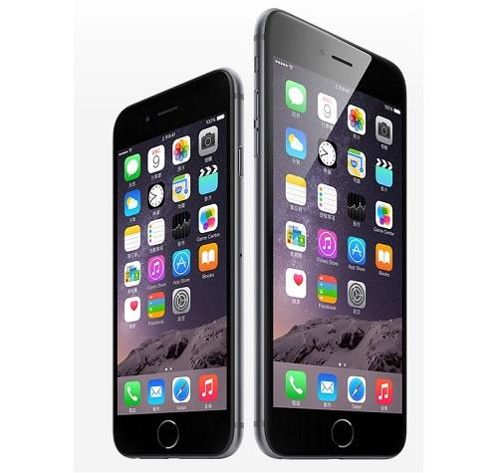
System Testing
Important traits of a good UI
Follows standards and guidelines
Intuitive
Consistent
Flexible
Comfortable
Correct
Useful

Slide 255
System Testing
Follows UI standards and guidelines
Macintosh Human Interface Guidelines
http://developer.apple.com/documentation/UserExperience/Conceptual/OSXHIGuidelines/XHIGIntro/chapter_1_section_1.html
Microsoft Windows User Experience
http://msdn2.microsoft.com/en-us/library/aa511258.aspx
These guides detail how software that runs on each platform should look and feel to the user.
When should a check box be used instead of a button?
When is it proper to use information, warning, or critical messages?

Slide 256
System Testing
Follows UI standards and guidelines (cont’d)
The standards guidelines for a platform should be treated as an addendum to the product specification.
Test cases should be created based on the standards guidelines in addition to the test case created from the product’s specification.
If the development platform does not have a standard, the design team must create usability standards for the software itself.

Slide 257
System Testing
Intuitive UI
Is the UI clean, unobtrusive, not busy?
Are responses obvious and there when you expect them?
Is the UI organized and laid out well?
Are the inputs acknowledged?
Do the menus go too deep?
Is there excessive functionality?
Is there information overload?
Does the help system really help the user?

Slide 258
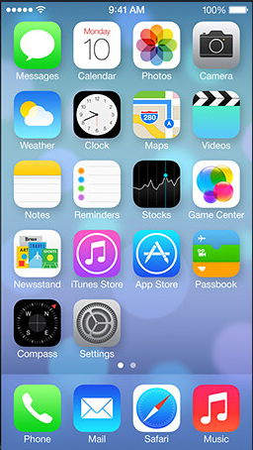
System Testing
Consistent UI
Shortcut keys and menu selections
F1 should always get you Help in MS Windows.
Different UI paths should have the same F key to execute a feature.
Terminology and naming
Is Find sometimes called Search?
Audience
Consider the success of the UI of the car and ATM.
Placement of buttons such as OK and Cancel
In Mac OS, the OK button is always on the right.
In MS Windows the, the OK button is on the left and Cancel is on the right.

Slide 259
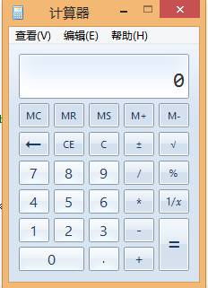
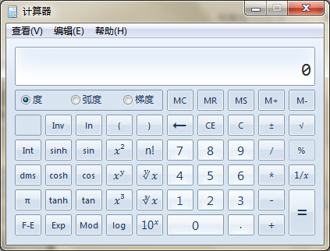
System Testing
Flexible UI
Users like choices … but not too many.
E.g., MS simple and scientific calculators
Flexible UIs provide:
State jumping
Many alternative ways to achieve the same goal.
State termination and skipping
“If you know your party’s extension enter it at any time”.
Multiple ways to perform I/O
Excel allows many input formats (from keyboard or files) and many output formats (table, graphs, charts).

Slide 260
System Testing
Comfortable UI
Sounds like a strange notion …
Is the UI appropriate?
Sound effects in a computer game? How about a business application?
Does the UI handle errors well?
If there is no Undo/Redo feature critical operations may fail.
Is the feedback fast enough or too fast?
E.g., waiting for cash to come out of the ATM
Does excessive use cause harm?
E.g., Emacs hand

Slide 261
System Testing
Correct UI
Marketing differences
Are there extra or missing functions from what the marketing material states?
Language and spelling
Error messages often have spelling mistakes
Bad media (icons, images, sounds, videos) that for with the software UI.
WYSIWYG
E.g., does the printed Adobe Acrobat file look like the one on the screen?

Slide 262
System Testing
Useful UI
When testing a UI feature, ask if the feature you see actually contributes to the software’s value.
Many applets have useless features
E.g., dancing elves
Useless UI features waste time for the user, developer, and tester.

Slide 263
System Testing
Accessibility Testing (testing for the disabled)
Nearly 20% of American have some form of disability according to the 1997 US Census.
The following impairments make using computers especially difficult:
Visual
E.g., color blindness, tunnel vision, cataracts.
Hearing
E.g., partial or complete deafness.
Motion
E.g., injury can make using a keyboard or mouse difficult or impossible.
Cognitive and language
E.g., dyslexia or memory problems and using complex UIs

Slide 264
System Testing
Legal requirements
In the US, three laws apply to developing software with a UI that can be used by the disabled:
The Americans with Disability Act (ADA) has been applied to commercial Internet websites.
Section 508 of the Rehabilitation Act is similar to the ADA and applies to any organization that receives federal funding.
Section 255 of the Telecommunications Act requires all hardware and software that transfers information over the Internet/network/phone line be accessible to people with disabilities.

Slide 265
System Testing
Accessibility features in software
If the software being tested does not run on a platform that has specified accessibility features?
Accessibility features will have to be specified, programmed, and tested.
If your platform has built in accessibility features your software?
Software only needs to adhere to the platform’s standard for communicating with peripheral devices.
Remember to create test cases specifically to test for accessibility.
Add them to your configuration testing equivalence partitions.

Slide 266
System Testing
Microsoft Windows accessibility features
Sticky-keys: Allow Shift, Ctrl, Alt keys to stay in effect until the next key is pressed.
Filter-keys: prevents brief repeated keystrokes from being recognized.
Toggle-keys: plays tomes when Caps Lock, Scroll Lock, or Num Lock keyboard modes are enabled.
Sound-sentry: creates a visual warning whenever the system generates a sound.
Show-sounds: instructs program to display captions for any sounds or speech they make.

Slide 267
System Testing
Microsoft Windows accessibility features (cont’d)
High contrast: sets up the screen with colors and fonts designed to be read by the visually impaired.
Mouse-keys: allows the use of keyboard keys instead of he mouse to navigate.
Serial-keys: sets up a communication port to read in key strokes from an external (non-keyboard) device.

Slide 268
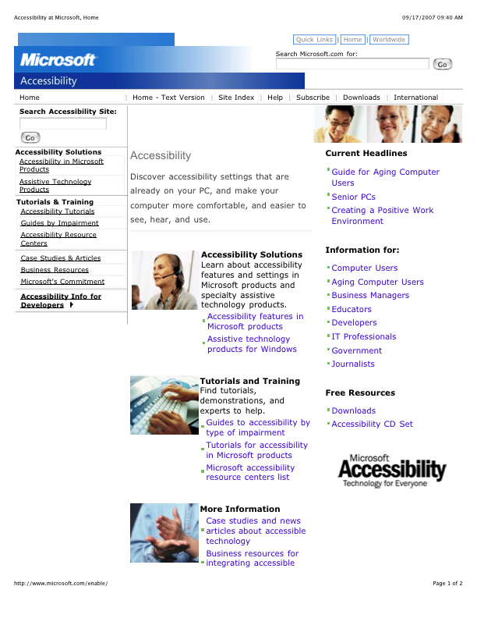
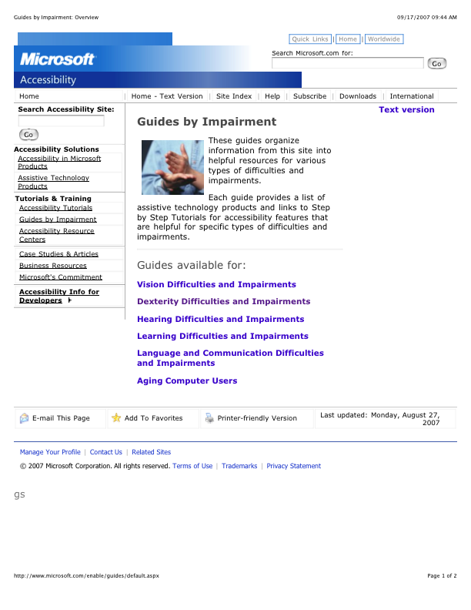
System Testing
Microsoft’s accessibility website

Slide 269
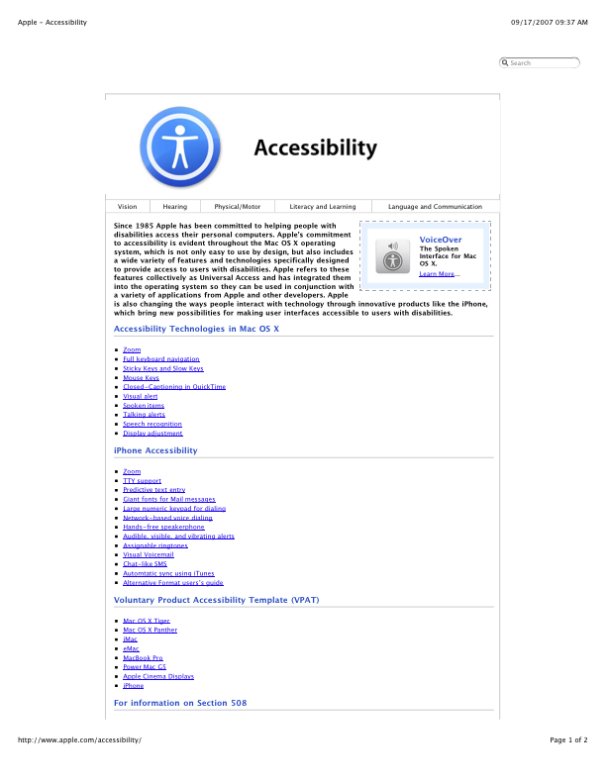
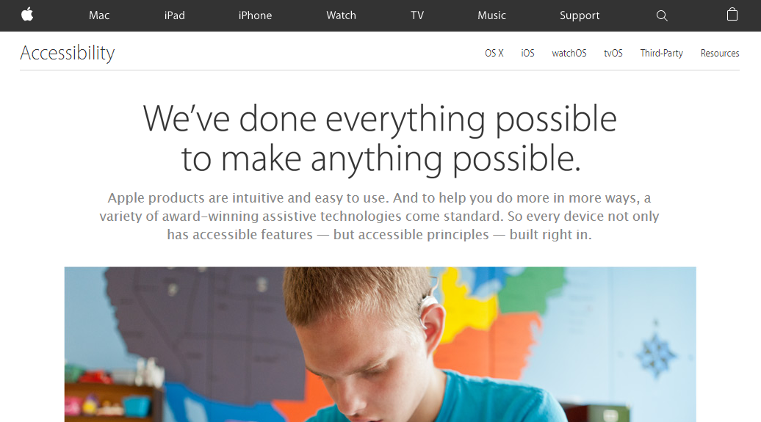
System Testing
Apple’s accessibility website

Slide 270
System Testing
System Testing
Example: Website Testing

Slide 271
System Testing
How to test a website
Easiest way to start is by treating the web site as a black box.
Look at a sample website such as www.apple.com to get a sense of the scale of such an endeavor.
Treat each page as a state with hyperlinks as state transitions.

Slide 272
System Testing
Website text
Web page text should be treated like documentation and tested using the techniques we described previously.
Check for …
correctness of contact information e.g., phone numbers, addresses
correctness of dates and copyright notices
title bar text, bookmark text on browser’s favorites
correctness of the ALT text (i.e., mouse over text)
layout issues when browser window is resized

Slide 273
System Testing
Website hyperlinks
Each link should be checked to make sure it jumps to the correct destination or website.
Ensure that hyperlinks are obvious:
E.g., underlined text, mouse pointer changes
If the link opens an e-mail message, test it
Send an e-mail and verify that you get a response.
Check for orphan pages that are part of the website but cannot be accesses through a hyperlink.
Someone forgot to create the link
Might be intentional … Google will find it, though

Slide 274
System Testing
Website graphics
Do all graphics load and display properly?
Is a graphic missing or incorrectly named?
Does the website intermix text and graphics?
Does the text wrap around the graphics?
What happens when the browser window is re-sized?
Does the page load fast enough?
Are there too many graphics?
Did you try to test the website on a dialup connection instead of a high-speed LAN?

Slide 275
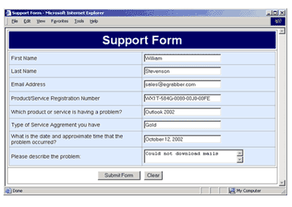
System Testing
Website forms
Forms are the text boxes, list boxes, and other fields for entering and selecting information on the web page.
Are the form fields positioned properly?
Are the fields the correct size?
Do they accept correct data?
Do they reject bad data?
Are optional fields really optional?
A favorite entry point for buffer overflow attacks (more on this later).

Slide 276
System Testing
“Grey-box” testing
A mixture of white-box and black-box testing.
You stick to black-box testing primarily and supplement it by taking a peek at the HTML to figure out how the website works.
For website testing it is worth looking at the HTML code.
It’s there, easy to look at, why not?
Not looking at the HTML code is wasteful, especially since HTML is such a simple language.
HTML is a tagging language for text and graphics.
To create dynamic web content requires that HTML be supplemented by programming code (e.g., Java applets, ActiveX, VBScript, CGI, Perl).

Slide 277
System Testing
White-box testing
To make sure you find the important bugs you should have some knowledge of the website’s programming:
Dynamic content
Database-driven web pages
Programmatically created web pages
Server performance and loading and security

Slide 278
Dynamic content
Dynamic content is graphics and text that changes based on certain conditions.
E.g., time of day, weather, stock tickers
Client-side programming involve embedding scripting code (e.g., JavaScript) into HTML.
Less efficient if the computations are expensive
Code is local, easy to access for testing
Server-side programming is code located on the server.
More efficient for intensive calculations
Requires access to the web server to view the code (might be a problem for testing).

Slide 279
Database-driven web pages
Most E-commerce that show catalogs or inventories are database driven.
E.g., Amazon
Data is pulled from the database, formatted into HTML and sent to the web browser for viewing A three tier architecture is used:
Tier 1: web browsers (presentation)
Tier 2: web page formatter (converts data from Tier 3 to HTML)
Tier 3: database (queried by Tier 2)

Slide 280
Programmatically- Created web pages
HTML or code is generated by a program.
E.g., a web designer may drag and drop elements in a layout program, press a button, and get an HTML page.
Compilers do this all the time, except they translate high-level language code (Java source code) into low-level code that can be executed natively or on a VM (e.g., byte code).
Testing these systems is like testing a compiler …
Automation? (Selenium) (Video)

Slide 281
System Testing
Server performance loading and security
Popular websites can receive millions of hits per day.
www.youtube.com hits 100 Million Videos per day
Each hit requires a download of data from the website’s server to the browser’s computer.
You need to simulate millions of connections and downloads to test a system for performance and loading.
Security issues include:
Denial of service attacks
Buffer overflow attacks

Slide 282
Configuration and compatibility testing
Hardware platform
Mac, PC, PDA, WiFi wristwatch?
Browser software version
Firefox 1.0, IE 6.0, Pocket IE, Netscape 7.2, Safari 2.0.4
Browser plug-ins
To play specific types of audio or video files
Browser options
Security options, ALT text, plug-in, pop ups
Video resolution and color depth
640x480, 800x600, 1024x768, 1280x1024, 256 colors, 16 colors
Text size
Small fonts, medium fonts, large fonts
Connection speed
DSL, modems of varying speed.

Slide 283
System Testing
Usability testing: Jacob Nielsen’s top 10 mistakes in web design
Gratuitous use of bleeding-edge technology
Scrolling text, marquees, and constantly running animations
Long scrolling pages
Non-standard link colors
Outdated information (need website maintenance)
Overly long download times (more than 10 sec to load)
Lack of navigation support
Orphan pages
Complex website addresses (URLs)
Using Frames (just open another window …)

Slide 284
System Testing
Website testing tools
Check out www.netmechanic.com
Website testing is very labor-intensive.
Tools that automatically check websites for:
Browser compatibility
Performance problems
Broken hyperlinks
HTML standard adherence
Spelling on text

Slide 285
System Testing
Web applications
Website - requests are navigational requests.
Web Application - requests can affect the state of the business logic on the server.
Client
Browser
A
Web Server
B
Scripts and Application
Server
C
Database
Server
F
E
D
A: Request
B: Request for page generation
C: SQL command
D: Result set
E: Dynamically generated page
F: Response (dynamic | static page)

Slide 286
System Testing
Web application failures
A 2003 study by the Business Internet Group of San Francisco found that:
72% (29/40) leading e-commerce sites, and
68% (28/41) government sites contained Web application failures
25 “technical errors”
E.g., page not found, multiple attempts to subscribe to a service
3 data errors
E.g., page without text, wrong page returned

Slide 287
System Testing
What type of bugs? Study by Kallepalli and Tian [IEEE TSE].
Analyzed the logs of the Web pages of Southern Methodist University for usage and failure information.
Looked at data from 26 consecutive days.
Total number of “hits” 762,971 (~30,000 hits/day)
A “hit” is registered for each Web page if one of the following happens:
The HTML file corresponding to a page is requested.
Any graphics within the HTML page is requested.

Slide 288
System Testing
About the bugs
“Permission denied”
Unauthorized access to restricted resources
Is this a bug?
“File does not exist”
Wrongfully denied access to restricted or unrestricted resources e.g., wrong file access code

Slide 289
Software Quality
Topics in Testing Software
Software Quality

Slide 290
What is Software Quality Assurance?

Slide 291
What is Quality?
Quality – developed product meets it’s specification
Problems:
• Development organization has requirements exceeding customer's specifications (added cost of product development)
• Certain quality characteristics can not be specified in unambiguous terms (i.e. maintainability)
• Even if the product conforms to it’s specifications, users may not consider it to be a quality product (because users may not be involved in the development of the requirements)

Slide 292
What is Quality Management?
Quality Management – ensuring that required level of product quality is achieved
• Defining procedures and standards
• Applying procedures and standards to the product and process
• Checking that procedures are followed
• Collecting and analyzing various quality data
Problems:
• Intangible aspects of software quality can’t be standardized (i.e elegance and readability)

Slide 293
What are SQA, SQP, SQC, and SQM?
SQA includes all 4 elements…
Software Quality Assurance – establishment of network of organizational procedures and standards leading to high-quality software
Software Quality Planning – selection of appropriate procedures and standards from this framework and adaptation of these to specific software project
Software Quality Control – definition and enactment of processes that ensure that project quality procedures and standards are being followed by the software development team
Software Quality Metrics – collecting and analyzing quality data to predict and control quality of the software product being developed

Slide 294
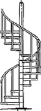
Software Development Process Spiral
Top-Down Design Model
IPDS
Software Development Phases

Slide 295
Software Development Cycle
Software Development Phase
• Software requirements
• Preliminary Design
• Detailed Design
• Code
• Unit Test
• Software integration
• Software Component Test
• Software System Test
• Maintenance and Support
End product
• SRS, IRS
• SDD, PQT/FAT/SAT Plans & Proc.’s, ICD, IDD
• PDL, User Manuals
• Code, UT Plan & Proc.’s
• UT Results
• VDD
• PQT Report
• FAT & SAT Reports
• Updates

Slide 296
Software Development Cycle (contd.)
Req.
Maint
PD
DD
SAT
FAT
CUT
PQT
Int

Slide 297
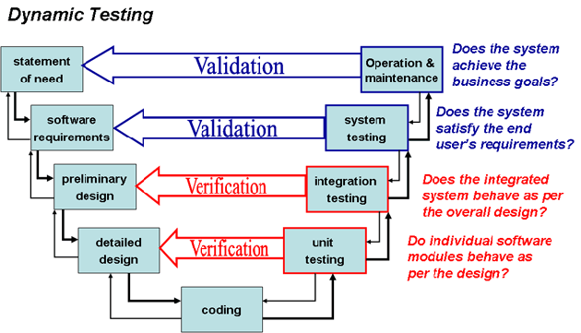
Software Development Cycle (contd.)

Slide 298
Software Quality Assurance
Element I

Slide 299
Why are Standards Important?
• Standards provide encapsulation of best, or at least most appropriate, practice
• Standards provide a framework around which the quality assurance process may be implemented
• Standards assist in continuity of work when it’s carried out by different people throughout the software product lifecycle
Standards should not be avoided. If they are too extensive for the task at hand, then they should be tailored.

Slide 300
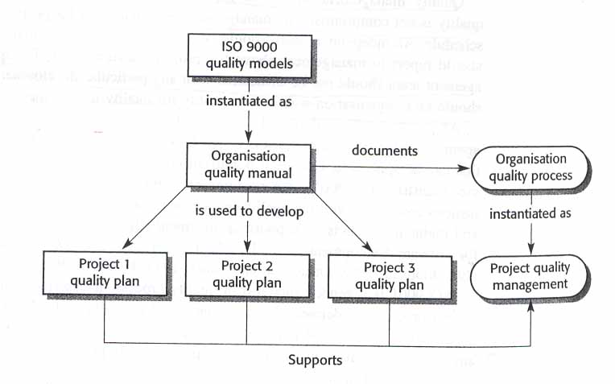
SDS a Simplistic approach
In most mature organizations:
• ISO is not the only source of SDS
• Process and Product standards are derived independently
• Product standards are not created by SQA

Slide 301
Process Standards
Process Standards – standards that define the process
which should be followed during software development
CMMI (Capability Maturity Model Integration)
ISO
CMM
CMMI
Organizational
Quality Manual
Organizational
SD Process STD’s
IPDS
Project SQP
Project SD Process STD’s
(SDP, IP, Method Sheets)
Project SCMP

Slide 302
Product Standards
Product Standards – standards that apply to software product being developed
ISO
STD’s
MIL/ Industry
STD’s
Organizational
Product STD’s
COTS
STD’s
Project Product STD’s (SDP, IP, Method Sheets)

Slide 303
Quality Models

Slide 304
ISO - 9000 Elements
Quality System Requirements
Management Responsibility
Quality system
Contract review
Design Control
Document control
Purchasing
Purchaser supplied product
Product identification and traceability
Process control
Inspection and testing
Inspection, measuring and test equipment
Inspection and test status
Control of non-conforming product
Corrective action
Handling, storage, preservation, packaging and shipping
Quality records
Internal quality audits
Training
Servicing
Statistical techniques
Software Quality Responsibilities
Management Responsibility
Quality system
Contract review
Design Control
Document control
Purchasing
-
Product identification and traceability
Process control
Inspection and testing
-
Inspection and test status
-
Corrective action
-
Quality records
Internal quality audits
Training
-
Statistical techniques

Slide 305
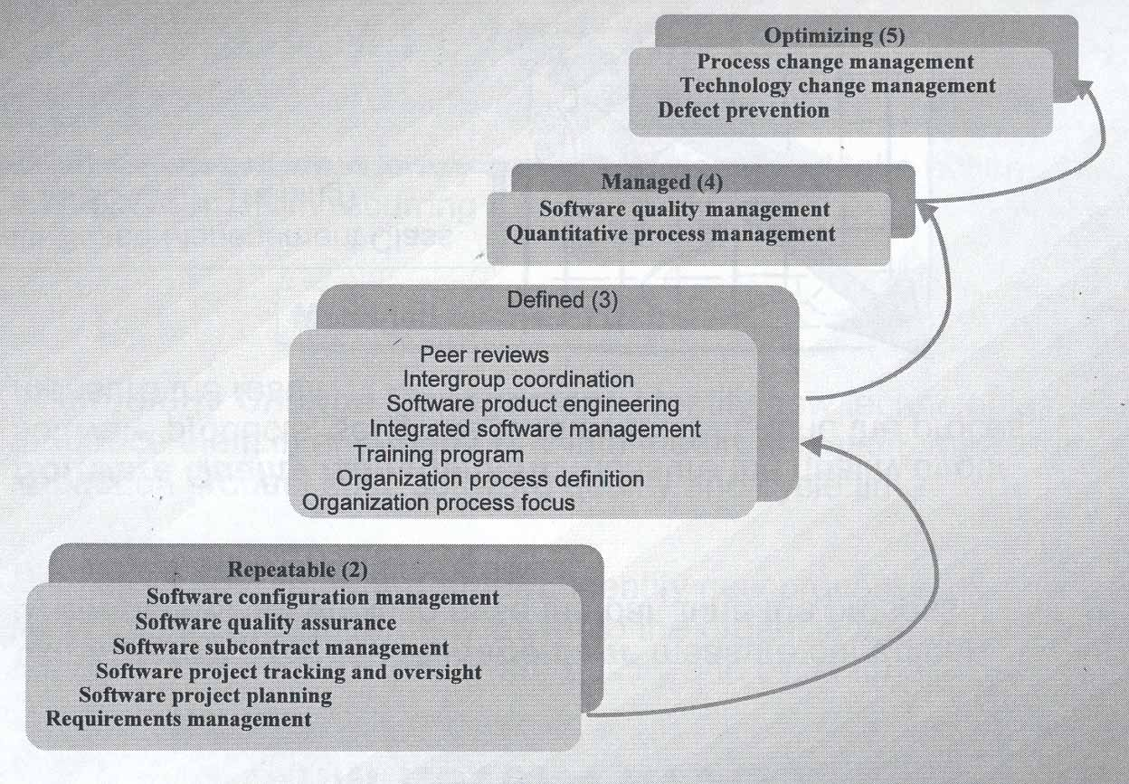
Capability Maturity Model KPA’s

Slide 306
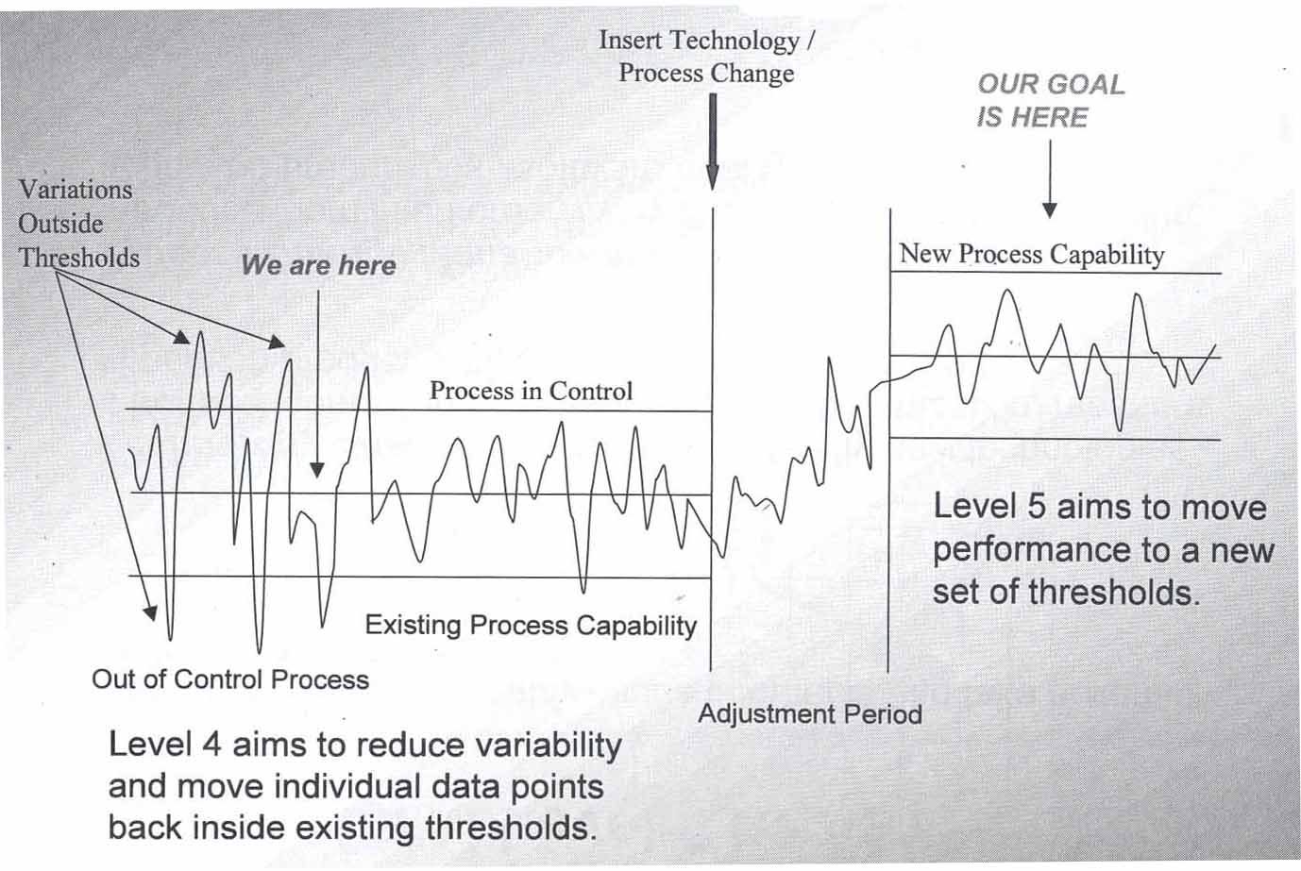
CMM Level’s 2-5

Slide 307
Documentation

Slide 308
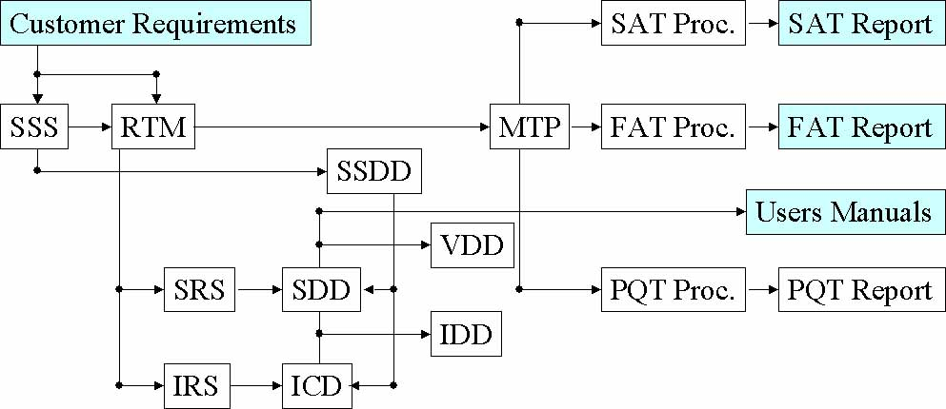
Documentation Hierarchy
• Documents are not the only tangible way of representing software products. The working software system is the most tangible way of representing software products.
• Documents are the best way to ensure software products’ understandability

Slide 309
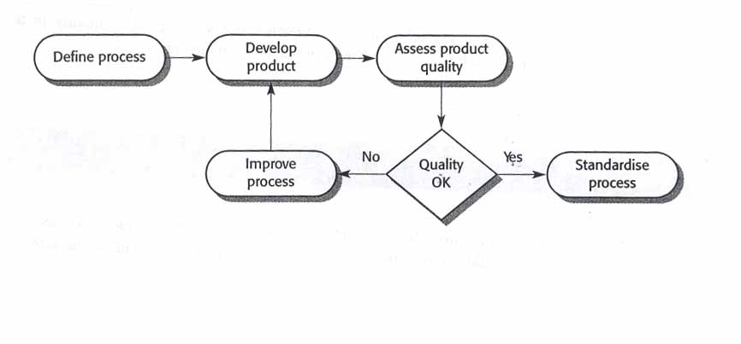
Process and Product Quality
Quality of development process directly affects the quality of
delivered products.
This is the factory approach. It doesn’t work because software is
designed rather then manufactured.

Slide 310
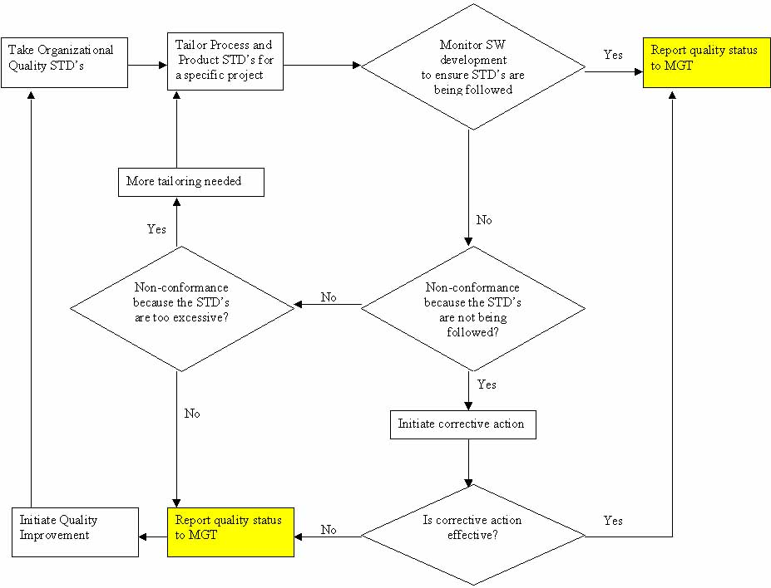
Process and Product Quality Creative Approach
• Quality Improvement – identifying good quality products,
examining the processes used to develop these products, and then
generalizing these processes so that they can be applied everywhere

Slide 311
Continuity and Independence of SQA
• Software Quality Assurance team must be independent in order to take an objective view of the process and report problems to senior management directly
• If prescribed process is inappropriate for the type of software product which is being developed, then it should be tailored
• The standards must be upheld no matter how small the task. Prototyping doesn’t mean no standards. It means tailored standards.
• Quality is FREE, if it’s Everyone’s Responsibility!

Slide 312
Software Quality Planning
Element II

Slide 313
Software Quality Plan
Tailoring - SQP should select those organizational standards that are appropriate to a particular product
Standardization - SQP should use (call out) only approved organizational process and product standards
If new standards are required a quality improvement should be initiated
Elements - SQP elements are usually based on the ISO-9001 model elements
SQP is not written for software developers. It’s written for SQE’s as a guide for SQC and for the customer to monitor development activities
Things like software production, software product plans and risk management should be defined in SDP, IP
Quality Factor’s shouldn’t be sacrificed to achieve efficiency. Don’t take the job if quality process can’t be upheld

Slide 314
Software Quality Control
Element III

Slide 315
Methods of Software Quality Control
SQC involves overseeing the software development process to ensure that the
procedures and STD’s are being followed
The following activities constitute SQC:
• Quality Reviews - in-process reviews of processes and products
Reviews are the most widely used method of validating the quality of processes and products. Reviews make quality everyone's responsibility. Quality must be built-in. SQE is responsible for writing Quality Engineering Records (QERs) documenting their participation in these reviews.
• Tests - end-result verifications of products. These verifications are conducted after the software has been developed. Test procedures are followed during conduct of these activities. SQE is responsible for keeping the logs and some times for writing the test report.
• Quality Audits - in-process verifications of processes. These audits are conducted periodically (twice a month) to assess compliance to the process STD’s.

Slide 316
Quality Reviews
• Peer reviews - reviews of processes and products by groups of people. These reviews require pre-review preparation by all participants. If a participant is not prepared, then the review is not effective. This type of review requires participation of the SQE, moderator, recorder, author(s), and one or more critical reviewers. All issues found during these reviews are documented on AR forms.
• Walkthroughs - reviews of products by groups of people mostly without preparation. For example a requirements traceability review is a walkthrough. It involves tracing a requirement from customer requirements to the test procedures. All issues found during these reviews are documented on CAR forms.
• Desk inspections - reviews of products by individuals. These reviews involve people reviewing products by themselves (not in a group) and then submitting their comments to the author(s). The issues found during these reviews are treated in informal manner.

Slide 317
Tests
• Engineering Dry-run - test conducted by engineering without SQE. These tests include Unit Tests and engineering dry-runs of the formal tests. These engineering dry-runs are used to verify correctness and completeness of the test procedures. Also, these is the final engineering verification of the end-product before sell-off to SQE. All issues found during these tests are documented on STR forms.
• SQE Dry-run - test conducted by SQE. These tests include PQT, FAT and SAT dry-runs. These tests are used to verify the end-product before the formal test with the customer. An SQE is sometimes responsible for writing the test report. However, if a separate test group is available, then SQE is relived of this obligation. All issues found during these tests are documented on STR forms.
• TFR - test conducted as “RFR - run-for-record” with the SQE and the customer. These tests include FAT and SAT. These tests are conducted to sell the end-product off to the customer. SQE is present at all such tests. All issues found during these tests are documented on STR forms.

Slide 318
Quality Audits
• SQE Audits - audits conducted by SQE to verify that the process STD’s are being followed. Examples of these audits are IPDS compliance, Configuration Control, and Software Engineering Management. All findings for these audits are documented on QER forms. The results of the audits are distributed to the next level of management (above project level). If the issue(s) are not fixed then the findings are elevated to upper management.
• Independent Audits - audits conducted by ISO generalists or other independent entities to verify that the process STD’s are being followed. These audits are usually conducted on a division/facility level. The results of these audits are distributed to upper management.

Slide 319
Defect Detection
Formal bug finding activities include Quality Reviews and Tests

Slide 320
A Bug’s Life
Postponed
Rejected
P
X
New
Assigned
Open
Resolved
Merged
Tested
Verified
N
A
O
R
M
T
V
SCCB
Engineer
Engineer
Software Lead
Tester
SCCB
Approves STR
Accepts STR
Resolves STR
Plans Merge
Verifies Fix
Agrees Closure
Duplicate
Integrator
D
Performs Merge

Slide 321
Software Configuration Management
SCM – activities assuring that software products are properly identified and their transition is tracked. In many mature organizations SCM is not part of SQA responsibilities.
• Baseline Identification – identification of initial state of the product
• Change Identification – identification of changes made to the baseline
• Change Control – documentation of changes via revision history, change summary, or using automated development tools (ClearCase or Apex)
• Status Accounting – reporting changes to others and monitoring completeness of the project archives
• Preservation – keeper of the software products

Slide 322
Software Quality Metrics
Element IV

Slide 323
Metrics Collection
• Software measurement - the process of deriving a numeric value
for some attribute of a software product or a software process. Comparison of these values to each other and to STD’s allows drawing conclusions about the quality of software products or the process.
• The focus of the metrics collecting programs is usually on collecting metrics on program defects and the V&V process.
• Metrics can be either Control Metrics or Predictor Metrics
• Most of the “Ilities” can not be measured directly unless there’s historical data. Instead tangible software product attributes are measured and the “Ility” factors are derived using predefined relationships between measurable and synthetic attributes.
• The boundary conditions for all measurements should be established in advance and then revised once a large databank of historical data has been established

Slide 324
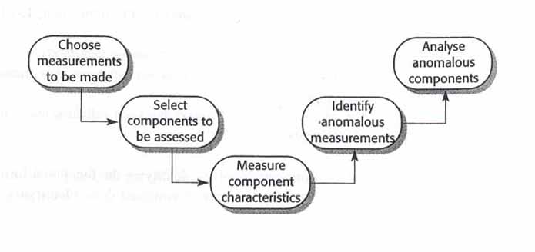
The Process of Product Measurement
1. Decide what data is to be collected
2. Assess critical (core) components first
3. Measuring component characteristics might require automated tools
4. Look for consistently (unusually only works in a factory) high or low values
5. Analysis of anomalous components should reveal if the quality of product is compromised

Slide 325
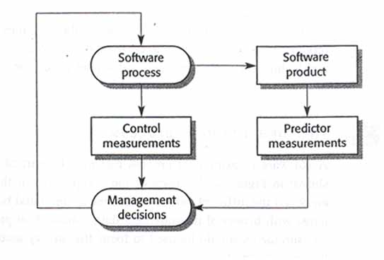
Predictor and Control Metrics
Examples of Predictor Analysis:
• Code Reuse: SLOC = ELOC = Ported Code
• Nesting Depth: ND > 5 = Low Readability
• Risk Analysis: # STR P1 > 0 at SAT = Low Product Reliability
Examples of Control Analysis:
• STR aging: Old STRs = Low Productivity
• Requirements Volatility: High Volatility = Scope Creep

Slide 326
Software Product Metrics
There are two categories of software product metrics:
1. Dynamic metrics – this metrics is collected by measuring elements
during program’s execution. This metrics help to asses efficiency and
reliability of a software product. The parameters collected can be
easily measured (i.e. execution time, mean time between failures)
2. Static metrics – this metrics is collected by measuring parameters of
the end products of the software development. This metrics help to
asses the complexity, understandability, and maintainability of a
software product. The SLOC size and ND are the most reliable
predictors of understandability, complexity, and maintainability.

Slide 327
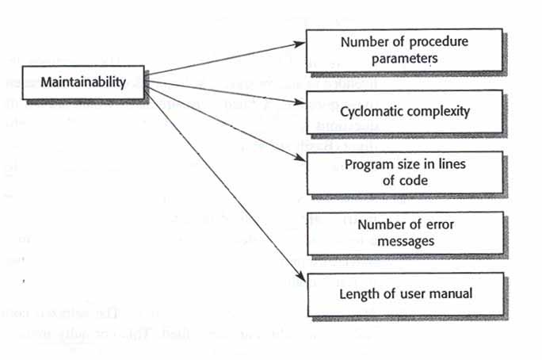
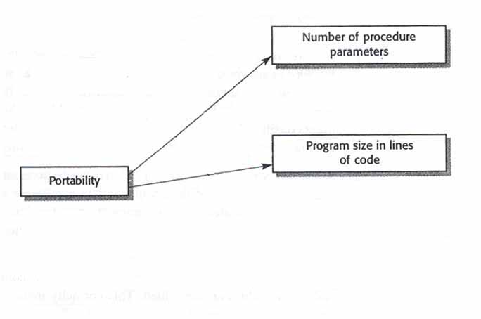
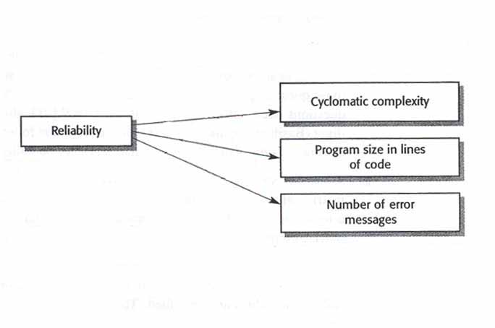
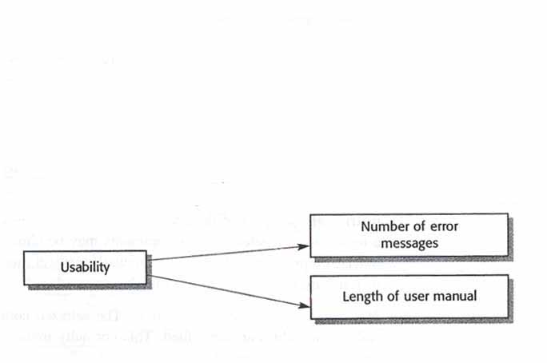
The Ilities
The specific metrics that are relevant depend on the on the project, the goals of the SQA, and the type of SW that is being
developed.

Slide 328
Defect Prevention
Defect Prevention – establishment of practices that lower the reliance
on defect detection techniques to find majority of the bugs
• Lessons learned – learning from other peoples experiences and sharing own experiences with the other projects
• Managing With Metrics – collecting the metrics, understanding it, and making changes to the product or process based on analysis. Metrics must be standardized to be effective.
• Risk Analysis – identifying potential risks and opportunities early in the program and tracking them to realization.
• Build freeze – no changes are made to the code during formal tests.
• Unit-level testing guidelines – test plans and procedures for each UT
• Baseline acceptance criteria – establishment of closure criteria in advance (i.e. no P1 STRs at FAT TRR)

Slide 329
When you see these slides it means you are preparing the exam Good Luck!

